Slide 1

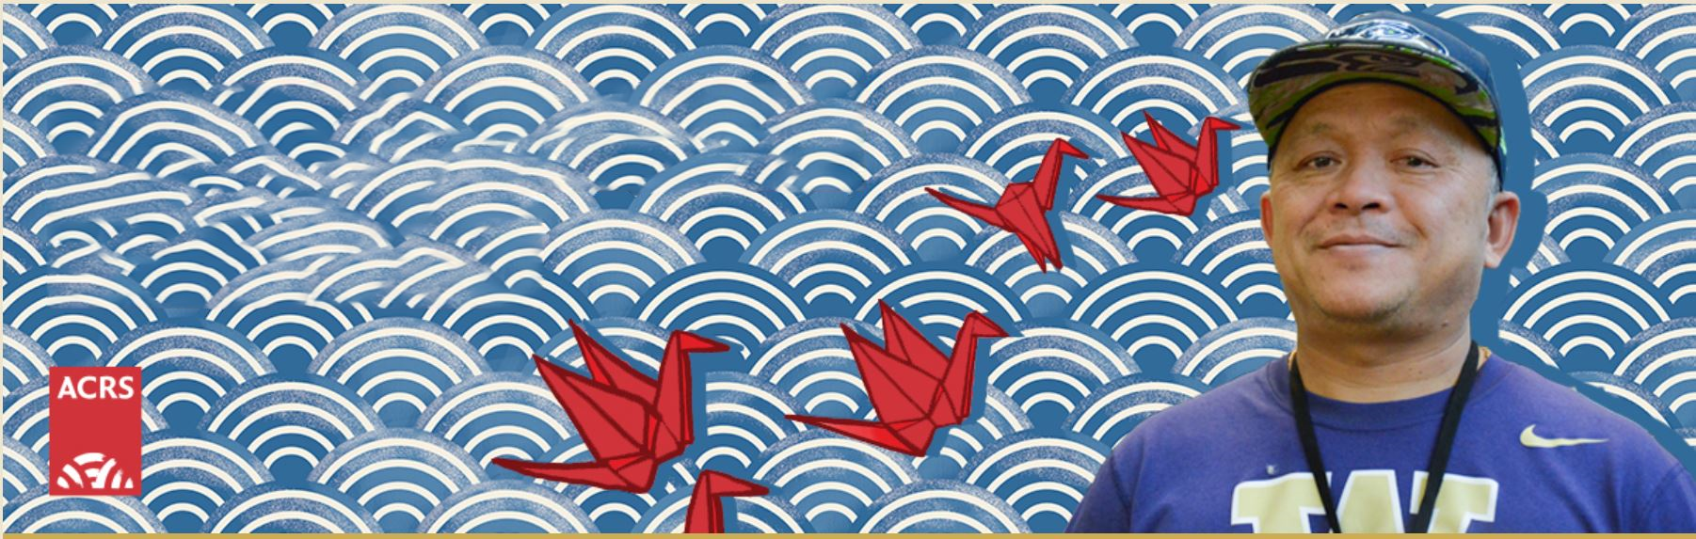
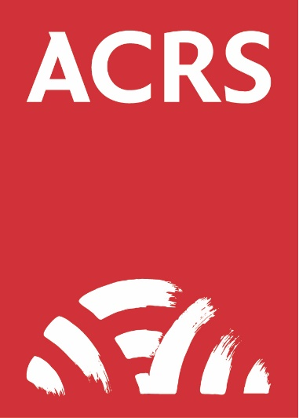

Adult Mental Health (AMH) Services
Psychiatric Care
Counseling and Therapy
Case Management
Physical and Mental Integration
Notes:
Your notes here

Slide 2

Over 50 Years of Healing
Founded in 1973 by a pioneering grassroots movement, Asian Counseling and Referral Service (ACRS) is dedicated to eliminating the risks of misdiagnosis, systemic exclusion, and linguistic trauma for immigrant, refugee, and native-born Asians and Native Hawaiians/Pacific Islanders (A&NH/PI) communities.
Notes:
Your notes here

Slide 3
Culturally Tailored Care
Bicultural Safety
ACRS deliberately pairs clinical practitioners and case managers who share similar lived cultural backgrounds with clients. This unique approach creates immediate emotional safety, reduces stigma, and establishes deep trust in professional clinical spaces.
Notes:
Your notes here

Slide 4
Fluency in 40+ Languages We break language barriers to deliver true healing. By utilizing bicultural staff fluent in over 40 Asian, Pacific Islander, and European languages, we ensure complex mental distress is accurately communicated and treated without translation error.
Notes:
Your notes here

Slide 5
Outpatient Core Services
Counseling & Therapy
Culturally sensitive individual, group, and family therapy addressing severe distress, depression, PTSD, anxiety, and complex transitional trauma
Case Management
Dedicated case managers who partner closely with clients to navigate the healthcare system, legal structures, and community resources
Psychiatric Care
Thorough psychiatric clinical evaluations and medication management coordinated by our culturally competent psychiatrists and psychiatric nurses
Notes:
Your notes here

Slide 6

Integrated Primary Care
Physical and Mental Integration
In partnership with International Community Health Services (ICHS), ACRS houses an on-site primary care medical clinic directly within our Seattle main facility.
This integration facilitates seamless prevention, early physical disease identification, and comprehensive holistic care for physical and behavioral health conditions under one roof.
Notes:
Your notes here

Slide 7
Holistic wellness Treatments
Holistic Wellness Treatment
Offers holistic wellness treatments, including acupuncture, to support clients’ mental, physical, and emotional wellbeing. These culturally grounded approaches can help reduce stress, manage pain, support relaxation, and complement each client’s path toward healing and recovery.
Acupuncture Services
On-site acupuncture treatments help clients release physiological stress, reduce bodily chronic pain, and alleviate deep-seated mental distress.
Notes:
Your notes here

Slide 8
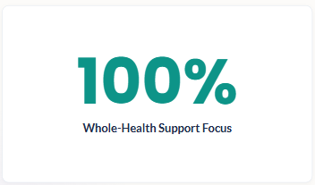
Socioeconomic Security
Social Determinants of Health
Recovery goes far beyond therapeutic counseling. True outpatient success requires stable income and secure living arrangements to remove survival stress.
Supported Employment
We partner to assist clients with psychiatric diagnoses in obtaining competitive and meaningful local careers.
Housing & Day Activities
Direct assistance is provided for stable
housing navigation, coupled with social
integration activities at Club Bamboo Senior Center.
Notes:
Your notes here

Slide 9
Program Eligibility & Coverage
Coverage Type | Program Eligibility Context | Service Availability Tier
WA Apple Health (Medicaid) | All eligible King County residents with Medicaid benefits | Fully covered core services
Low-Income (Uninsured) | King County residents experiencing financial difficulties | Services adjust based on grant funding availability
Commercial Insurance | Individuals, couples, or families seeking outpatient care | Direct referrals accommodated through ACRS Therapy Associates
Notes:
Your notes here

Slide 10

Adult Mental Health Services
Thank you!
mhintake@acrs.org
(206) 695-7511
3639 MLK Jr. Way S
Seattle WA 98144
Notes:
Your notes here

