Slide 1


Address: 24437 Russell Rd #110 Kent, WA 98032
Phone: 253-216-4479
https://opendoorswa.org/

Slide 2
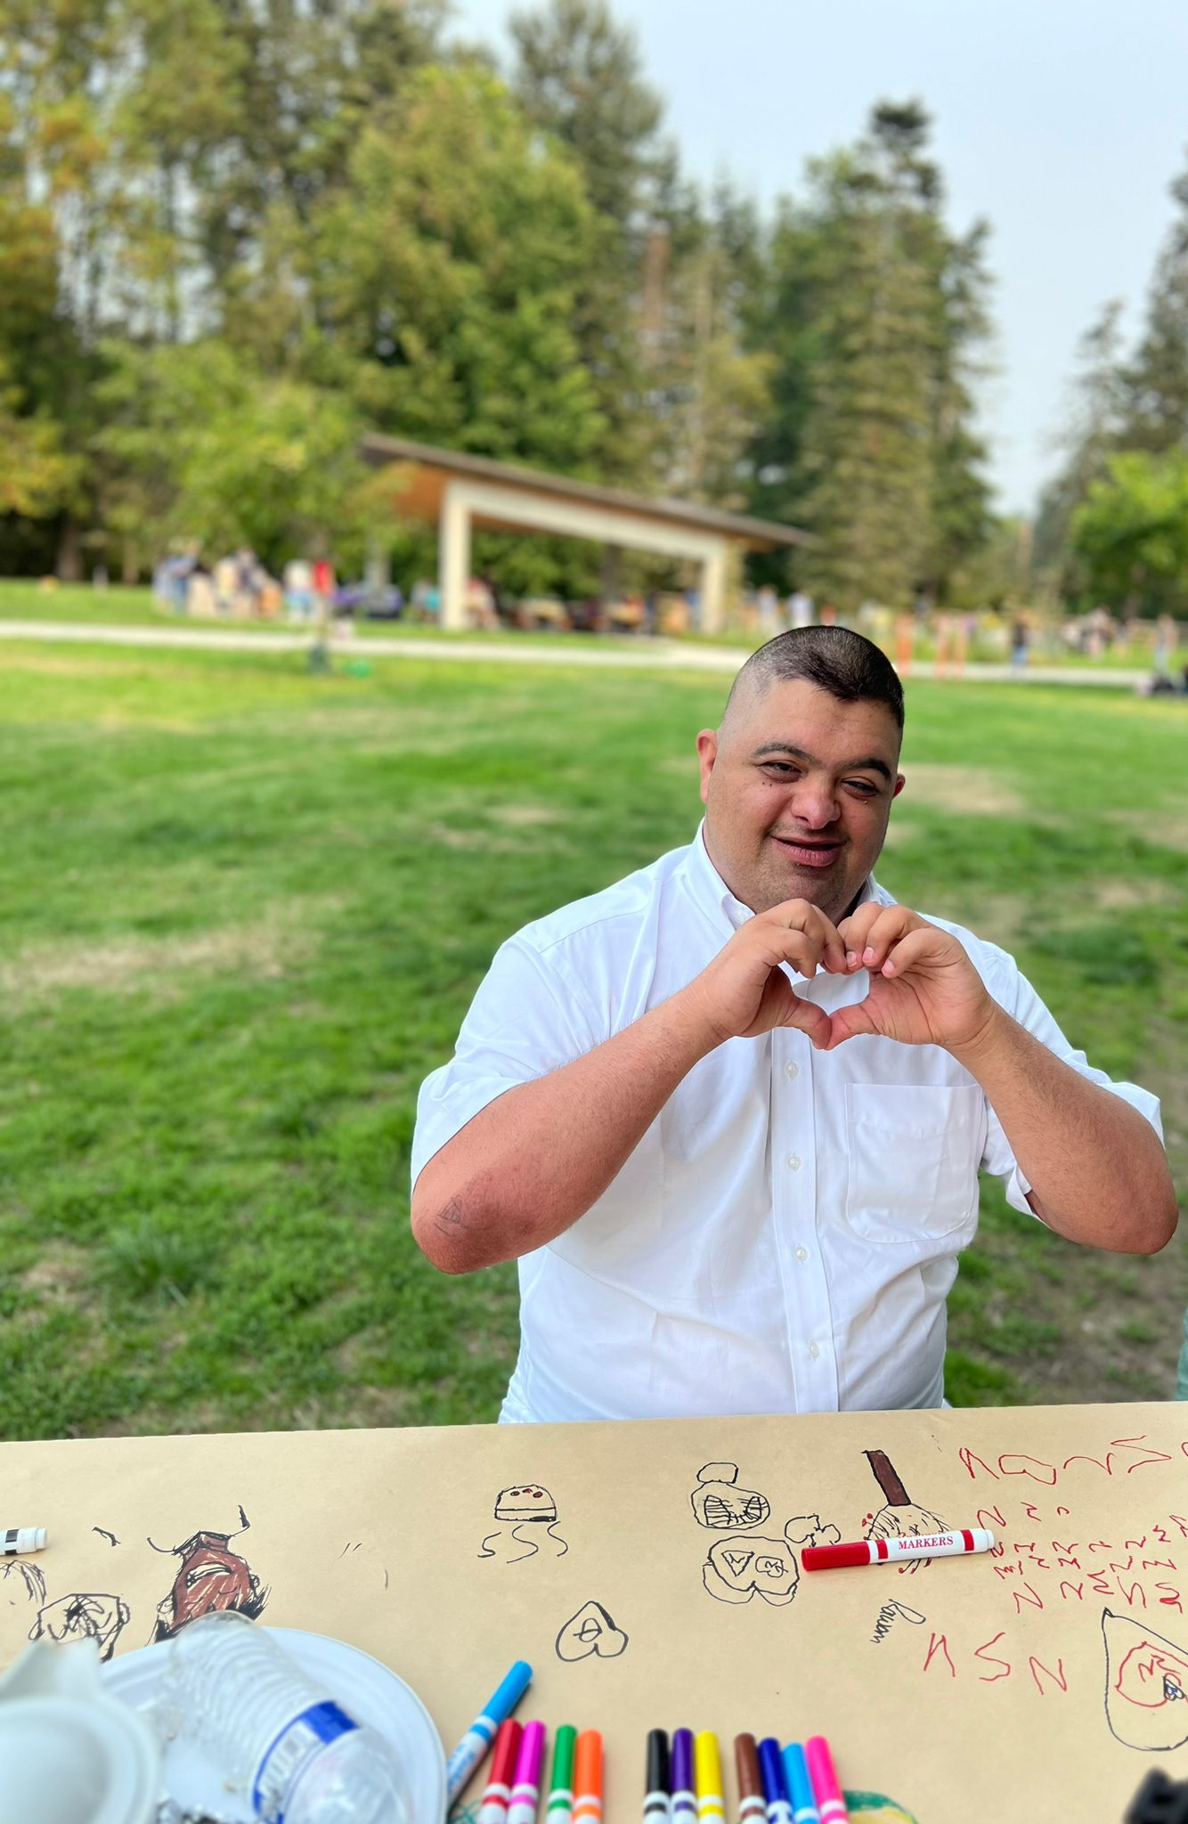
Our Mission and Vision
Mission:
Support and partner with individuals with intellectual and/or developmental disabilities and their families, regardless of cultural or linguistic background.
Vision:
Our vision is a world where all culturally and linguistically diverse individuals with intellectual and/or developmental disabilities and their families thrive in an inclusive society of their design.

Slide 3
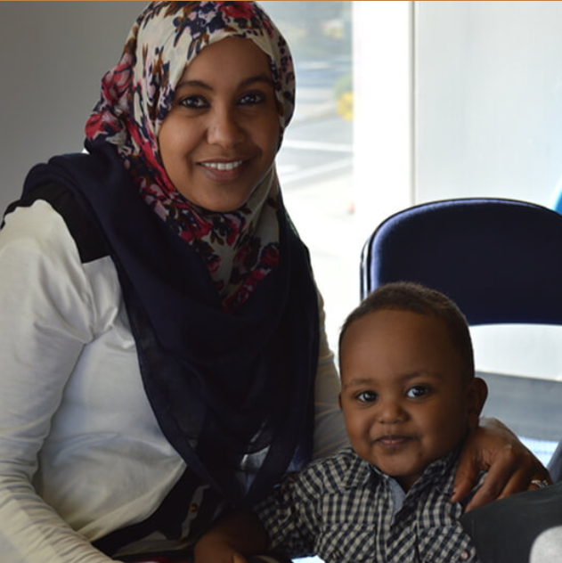
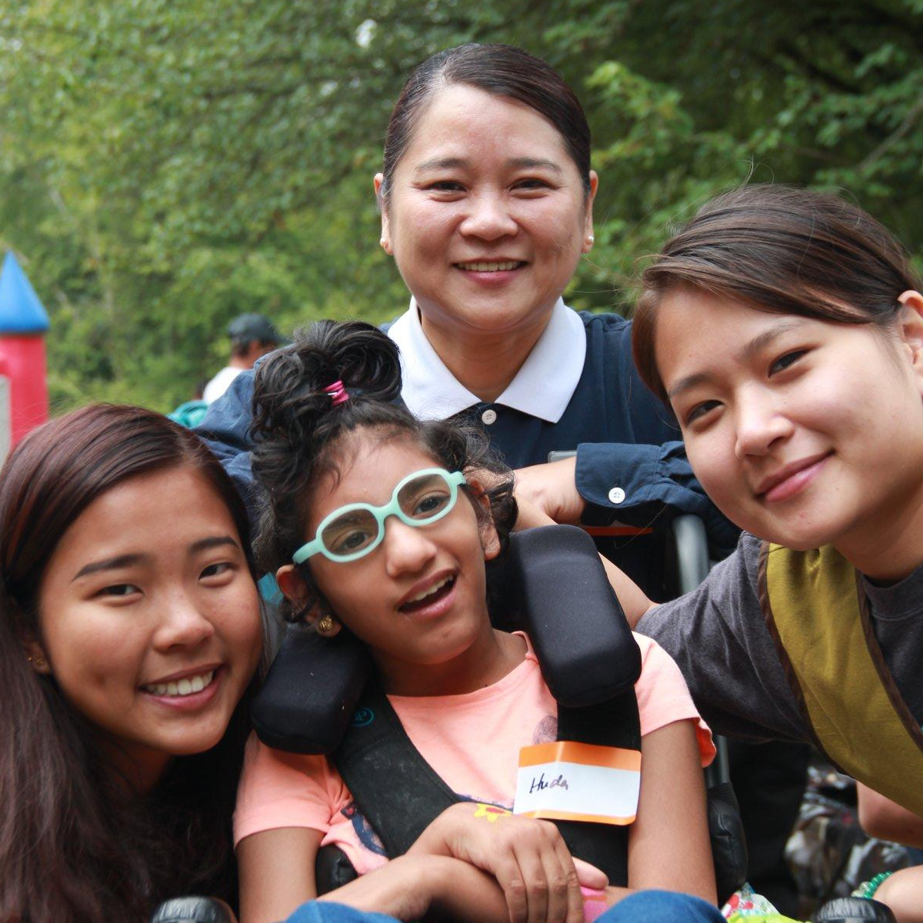
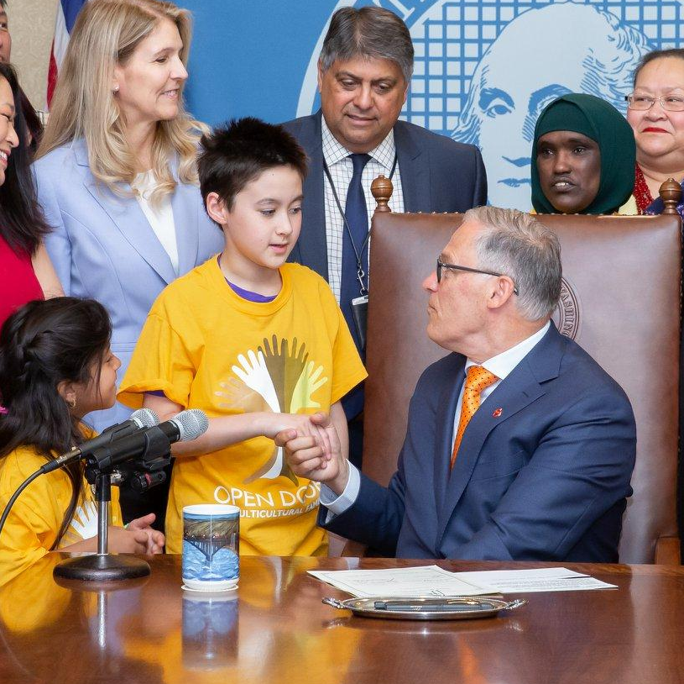
What Does ODMF Do?
We provide tailored support for individuals with intellectual and developmental disabilities, IDD, seniors and their family caregivers, regardless of age, disability, or cultural background.
Navigate services
Provide specialized
programming
Advocate for Systems Change

Slide 4
Cultural Brokerage
We pair families 1:1 with a staff member who shares their language and culture. Trusting relationships with families and a shared cultural context mean we can act as a bridge between families and the services and support they need. We pair an understanding of the family we work with and our expertise in the systems and programs that are available to them, to find the right solution for them.

Slide 5



Who Do We Work With?
Communities served in 2023
Out of a total of 2,545 clients
*Swahili, Punjabi, Dari, Kurdish, Oromo, and more
People Impacted
by Racism
810
Black/African American clients served 32%
People Impacted
by Ableism

Slide 6
Aging and Disability Services
18 and older adults with disabilities, Senior (60 +), and their unpaid family caregivers
King County
The program goal is to enable people to live in a community-based setting of their choice and age in their homes and communities

Slide 7
Services for Older Adults and Adults with Disabilities
Outreach
Information/ Assistance/ Referral
Care Coordination
Services for Unpaid Caregivers
Outreach
Information/ Assistance for Caregivers
Caregiver Assessment
Respite/ House chore & Errand Services Coordination
Caregiver Support Groups
Caregiver Training
Caregiver Counseling Referral

Slide 8
ADS Program Staff
Joann Scott, Program Manager, English: joanns@opendoorswa.org
Doris Fuentes, Case Manager Spanish: dorisf@opendoorswa.org
Amina Abdale, Case Manager, Somali: aminaa@opendoorswa.org
Min Cho, Senior Case Manager, Korean: minc@opendoorswa.org

Slide 9
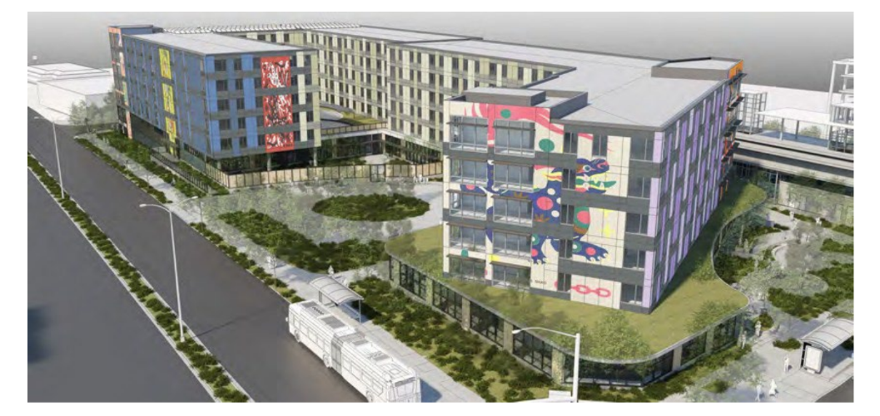
The Multicultural Village
233-unit affordable housing complex, with 20% of units designed for people with disabilities and their families
Inclusive Early Learning Center for 96 children with and without disabilities, and an inclusive accessible playground
ODMF Family Resource Center, Program & Service Spaces, and offices
Feet away from Sound Transit Kent/Des Moines Station

Slide 10

Questions?

Slide 11



Thank You
For
Joining Us!

