Slide 2

ZOOM & MEETING TIPS
Video is not mandatory,
but encouraged in breakout rooms.
Please mute yourself when you are not speaking.
Please put questions into the chat box.
Presentations will be uploaded to the CLC website.

Slide 3
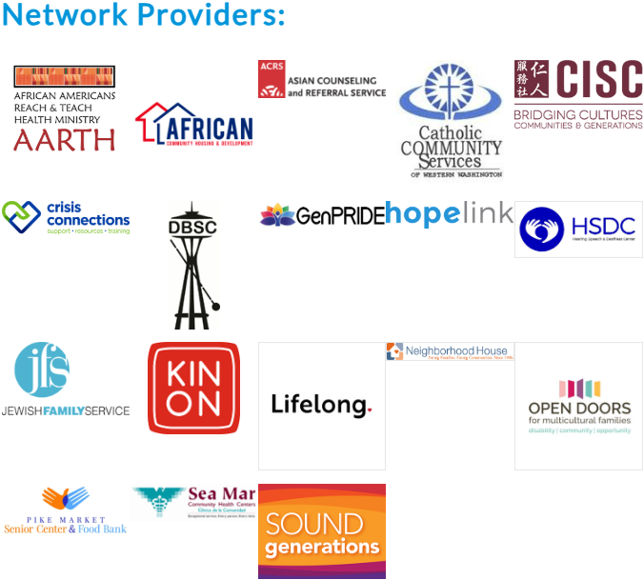
Community Living Connections is a network of providers, that can connect individuals with the right kind of help, when and where you need it. Older adults, adults with disabilities, caregivers, family members and professionals can contact the CLC to get objective, confidential information about community resources and service options.

Slide 4
MEETING AGENDA
10:00AM - 10:10AM
Introductions and CLC Overview
10:10AM - 10:30AM
Medicare EXTRA HELP – Sam Stones – Washington State Office of Insurance
Commissioner
10:30AM - 10:50AM
UW Social Work Students – Arden Hellmann, MSW – University of Washington
10:50AM - 11:05AM
Problem Management Plus – Najma Mohamed, RN – Neighborhood House
11:05AM - 11:25AM
Hospice 101 – Mary Pope RN, BSN – Gentiva Hospice
11:25AM - 11:30AM
Share out Resources

Slide 5
THANK YOU!
For more information visit:
https://www.communitylivingconnections.org/
Or Call toll free at 1-844-348-5464

