Slide 1
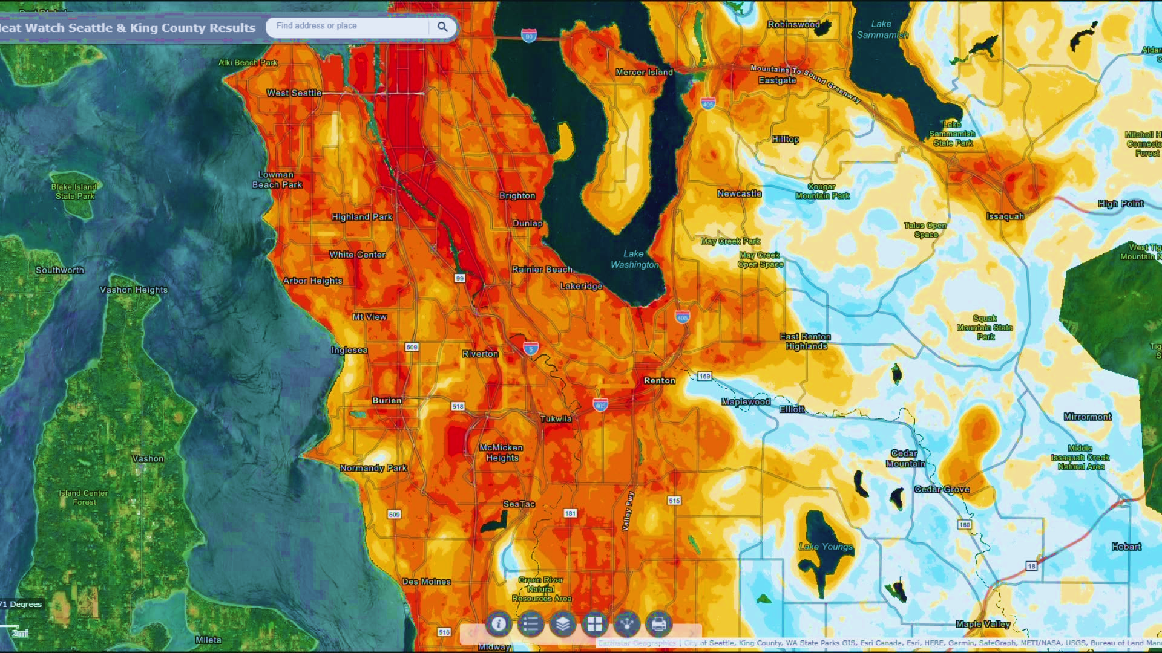
CLC Network Meeting
KING COUNTY EXTREME HEAT MITIGATION STRATEGY
Daaniya Iyaz, Extreme Heat Mitigation Strategy Specialist Lara Whitely Binder, Climate Preparedness Program Manager
17 APRIL 2024

Slide 2
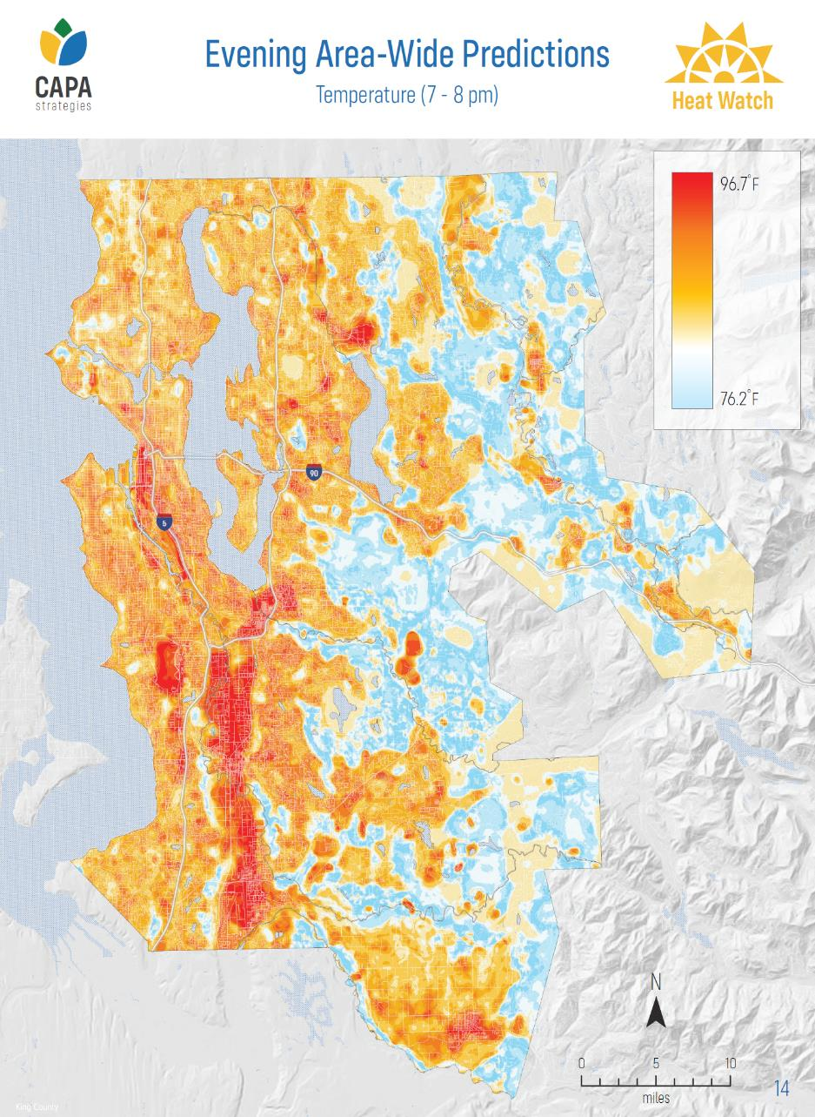
Strategy overview
2020 Urban Heat Island Mapping Project
Data collection: July 27, 2020
Urbanized areas retain more heat relative to less urbanized areas
Evening Area-Wide Temperatures (modeled; 7-8 pm)

Slide 3
King County’s First Extreme Heat Mitigation Strategy
Context: Priority action in King County Strategic Climate Action Plan; Supported by FEMA grant & King County funding
Audience: King County, local jurisdictions, community organizations
Focus:
Short-term actions (emergency management, communications, etc.)
Long-term actions (urban tree canopy management, building codes, etc.)
Completion date: Summer 2024
Notes:
The strategy is a set of recommended actions that have been identified collectively. County can’t require other jurisdictions to do things (can require ourselves to do things if County is lead on this, but can’t place mandates on others). We will do what we can to support implementation, take necessary steps to build this into our work.
Reiterate this is support, not a mandate

Slide 4
HOW DOES THE STRATEGY HELP with heat resilience?
Help People Stay Cool & Safe Indoors (5 actions)
Help People Stay Cool & Safe Outdoors (3 actions)
Cool Our Neighborhoods (5 actions)
Design for Heat (4 actions)
Increase Heat Safety Awareness (2 actions)
Support Heat Action (2 actions)
*as of 4/5/24 -- subject to change
Notes:
Verbally mention “now and in the future”
Draft document – details still evolving

Slide 5
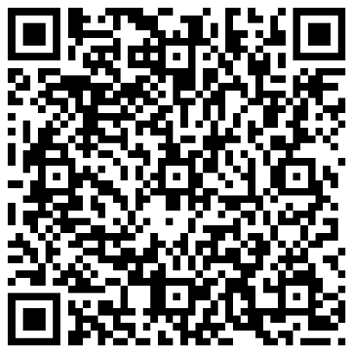
HEAT SAFETY SUPPORT FOR VULNERABLE COMMUNITIES
Goal: Utilize local and regional partnerships to provide in-home heat safety support for low-income seniors, people with disabilities, and homebound individuals. This could occur through:
Increasing access to portable air conditioners and other lower-cost options for cooling.
Partnering with businesses and service providers to buy, distribute, and install portable ACs and low-cost cooling items.
Creating shared “cool rooms” in senior and affordable housing facilities.
Expanding in-home heat safety support for low-income seniors, people with disabilities, and homebound individuals.
Resource and information distribution by service providers.
Including heat safety in wellness checks.
What else would you like to see in this action?
What are some key details/considerations we should include around this action?
Would you be interested in being listed as a partner?
Please scan this QR code to take a brief survey on this action by 04/29!
Notes:
more grounded in terms of work + what they would like to collaborate on.

Slide 6
HEAT STRATEGY: NEXT STEPS
May – Jun.: 1) Finalize all strategy actions. 2) Document production.
3) Final actions draft to share collaborators.
Summer 2024 Final strategy published
Jan. – Apr.:
1) Drafting action implementation details with identified partners for chosen actions. 2) Continued action review by Steering Committee.
THANK YOU! Please reach out to Daaniya Iyaz (daiyaz@kingcounty.gov) with any questions or follow-up comments.

