Slide 2
ZOOM MEETING TIPS
Video is not mandatory,
but encouraged.
Mute yourself when you are not speaking.
Please put questions into the chat box.
Presentations will be uploaded to the CLC website.

Slide 3
AGENDA
10:00 - 10:10 AM: Introductions/CLC Overview
10:10 - 10:30 AM: Neighborhood House
Emilie Laike
Transitions of Care Program
10:30 - 10:50 AM: Small Group Breakout Rooms
10:50 - 11:10 AM: African Americans Reach and Teach Health Ministry Angeilea Yancey-Watson
Intro to AARTH
11:10 - 11:30 AM: Open Doors for Multicultural Families
Faataualofa Apelu
Intro to ADS at ODMF
11:30 - 11:45 AM: Large Group Discussion/Feedback
11:45 - 12:00 PM: Updates, Announcements, Closing Remarks

Slide 4
Community Living Connections is a network of providers , that can connect individuals with the right kind of help, when and where you need it. Older adults, adults with disabilities, caregivers, family members and professionals can call us to get objective, confidential information about community resources and service options.
For more information visit:
https://www.communitylivingconnections.org/

Slide 5
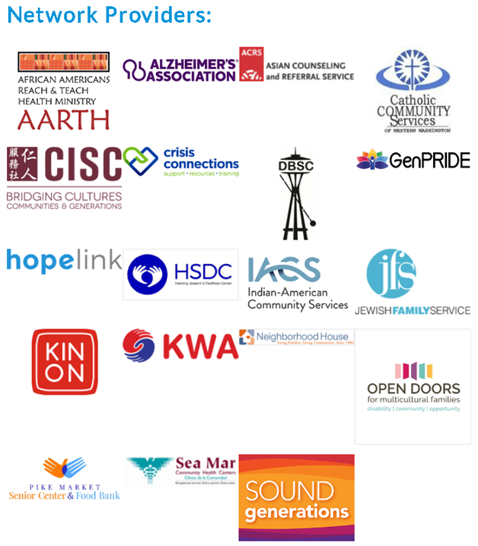

Slide 6
SUPPORTED BY:

Slide 7
PRESENTATION 1:
Emilie Laik
Care Transitions Program Coordinator

Slide 8
Small Group Breakouts (20 Mins)
Introduce Yourself!
Name, Organization, Role
Briefly describe what your organization/teams does.
Share a resource you know of or a resource you need.
Connect!

Slide 9
PRESENTATION 2:
Angeilea Yancey-Watson
Lead Program Coordinator

Slide 10
PRESENTATION 3:
Faataualofa Apelu
ADS Program Lead

Slide 11
Large Group Discussion
What topics would you like to learn more about during our meetings?
What went well? How can we improve for next year?
What time works best for these meetings to occur?

Slide 12
Network Updates, Announcements, & Resources

Slide 13
Disability Related Resources
Disability Fundamentals for Managers Training
Free, open-source, 30-minute interactive training that helps managers learn about disability awareness, etiquette, disclosures and accommodations, and holding accessible meetings and event
https://disabilityin.org/resource/disability-fundamentals-training-for-managers/
Toolkit For People With Disabilities (Northwest ADA Center)
Intended to provide information and guidance about the Americans with Disabilities Act (ADA) to people with disabilities. Included are materials that may promote equal opportunity in employment and equal access to goods and services.
https://nwadacenter.org/audience/people-disabilities
CareLearn (DSHS)
If you are a long-term care professional working in an adult family home, assisted living facility, enhanced services facility and/or in-home care settings, CareLearn Washington is a free online training portal to help you access convenient, affordable and quality online training.
https://carelearnwa.com/

Slide 14
Resource for Undocumented Immigrants: WA Healthplanfinder
“Starting this November, everyone who lives in Washington state will have the opportunity to buy health and dental insurance through Washington Healthplanfinder, regardless of immigration status..”
https://www.wahealthplanfinder.org/us/en/health-coverage/who-can-sign-up/immigrants.html

Slide 15
Thank you for joining us today!

