Slide 1
Volunteer Health Coach Program at Valley Medical Center
Janitsa Z. Dolan, MSW, LASW
Health Coach Program Social Worker

Slide 2
Objectives
By the end of this presentation, you will know…
Our purpose
Who our volunteers are
Which patients qualify
How a patient gets referred
The patient experience
Other programs currently active
That we are effective

Slide 3
6-month Program Purpose
A pilot program within Valley Medical Center’s Value Based Initiatives that aims to support patients with chronic disease in making lifestyle changes—and addressing social drivers of health (SDoH)—that will result in measurable clinical improvements.
Whole-Person Approach
Program is comprised of
Community volunteers
Patients
Program Staff
Notes:
6-month terms run from January to June and July to December.

Slide 4
Volunteer Health Coach Criteria
Adult 18+ that live in King County
Must be fluent in speaking and reading English
Access to a Computer and Meets software requirements
Attend an Info-session with Program Manager Laurie King, RN
Completion of 12 week Student Course
Motivational Interviewing skills
Basic self-management skills for common chronic diseases
Community Resources
Must commit to program for 6 months after course
Pass a Background Check & Complete HIPAA training
Notes:
Weekly commitment for Volunteers: 2-4 hours
As a student: for class and homework
As a coach: for team meeting, visits with patient, documentation, and research (if needed)

Slide 5
Patient Criteria
Adults 18+ that live in King County
Have one or more chronic condition for which lifestyle change may result in measurable improvement
Independent with Activities of Daily Living
Needs to be established with a Valley Medical Center Primary Care Provider
Desire to work with a volunteer coach

Slide 6
How Patients are Referred
Any Valley Primary Care Provider may refer through the Epic referral process or by sending a staff message in Epic to Program Manager, Laurie King RN.
Referrals will be prioritized based on availability of coaches and risk stratification including:
Medicare/Medicaid status
Frequent ED visits or admissions
Demonstrated difficulty navigating the healthcare system and community resources
Valley Risk score of 24 or higher
Notes:
Epic is the electronic health record that Valley uses for all documentation and communication of health records.

Slide 7
Next Steps
Patient deemed eligible by out Program Manager Laurie King, RN through a chart review and conversation with the patient.
Patient is matched with a Volunteer Health Coach
Initial assessment conducted by Program Staff to evaluate health-related goals and needs caused by Social Drivers of Health
Coach conducts weekly visits with patient
Notes:
Weekly visits can be via phone, in-person (not in-home), or via Program’s HIPAA compliant Zoom

Slide 8
One-on-One Visits
Volunteer Health Coaches meet with their patient to…
elicit needs and concerns of patient by utilizing MI skills
support patient in identifying and documenting S.M.A.R.T. (specific, measurable, achievable, relevant, and timely) goals to define actions needed to address identified needs
collaborate and advocate with community resources to connect patient
utilize empathy and cultural humility in forming a caring relationship with the patient
re-assess for barriers to health, progress toward goals, and demonstrated connection to community resources
Coaches will then communicate with the patient’s VMC care team through visit reports that are uploaded into Epic by Health Coach Program Staff.

Slide 9
Additional Opportunities
Community Connections (~3 months)
Aims to support patients in reducing loneliness and social isolation by making meaningful connections to community activities, organizations, and/or programs.
~30 Day Coach Support
Aims to support patients with acute clinical needs in connecting to community resources necessary to improve health outcomes and reduce risk of admission or re-admission.
Notes:
Conducted by experienced health coaches who have already worked with a patient for 6 months.

Slide 10
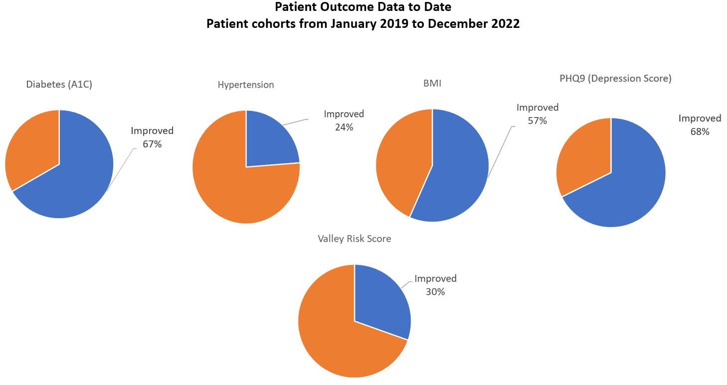
Are We Effective?

Slide 11
Testimonials
Through this program, I have learned so many things. One of the main things I have taken away is to empower patients to set their own goals and guide their own path toward better health. . .
Volunteer Health Coach
I learned a bunch of stuff personally. [My health coach] has been an amazing supporter and guy to where I ask a question and he didn’t make the decision for me, but allowed me to make the decision myself. . . Also, meal prepping, like with buffet style meal prepping vs. individual meals. That’s probably the biggest lifestyle changes. . .
Health Coach Participant

Slide 12
Program Contact Information
www.valleymed.org/healthcoach/
Laurie King, MSN, RN, CCCTM
Manager, Volunteer Health Coach Program
Laurie_King@valleymed.org
425-690-6667
Janitsa Z. Dolan, MSW, LASW
Social Worker, Volunteer Health Coach Program
Janitsa_Dolan@valleymed.org
425-690-6678

