Slide 1
MV Transportation
2023

Slide 2
MV Transportation: We Provide Freedom (Video)
Ref: https://youtu.be/qSXpJ4g2jJs

Slide 3
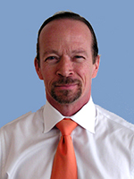
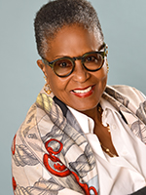
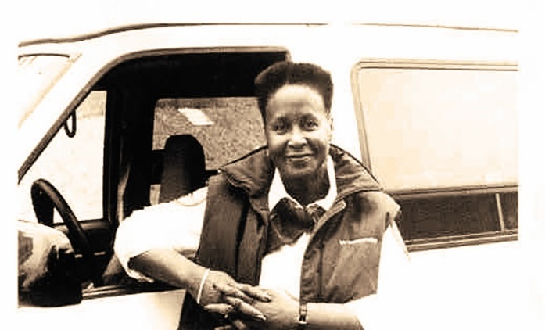
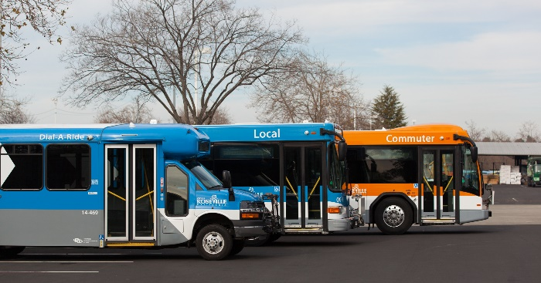
MV’s Rich History
Founded in 1975 by Alex and Feysan Lodde in San Francisco.
With just two vans, the Loddes served the elderly and people with disabilities who had limited transportation options during that time.
In 1990, operating as MV Transportation, the company was well-prepared to respond to 1990 landmark Americans with Disabilities Act, mandating “paratransit” for passengers with disabilities.
The company won its first government contract in 1984 and soon added fixed-route services, followed by shuttle and school in the early 2000s.
Based in Dallas, Texas, MV now provides transportation services to over 200 transit agencies and corporations across the U.S. and Canada.
With 20,000 team members, 11,000 vehicles, and over $1B in revenues, MV is the largest privately-owned transportation contract service company in North America serving over 110 million passengers annually.
The Loddes still own MV today.

Slide 4
Transit Instruction Program
Community Outreach Coordinator Christiana Williams

Slide 5
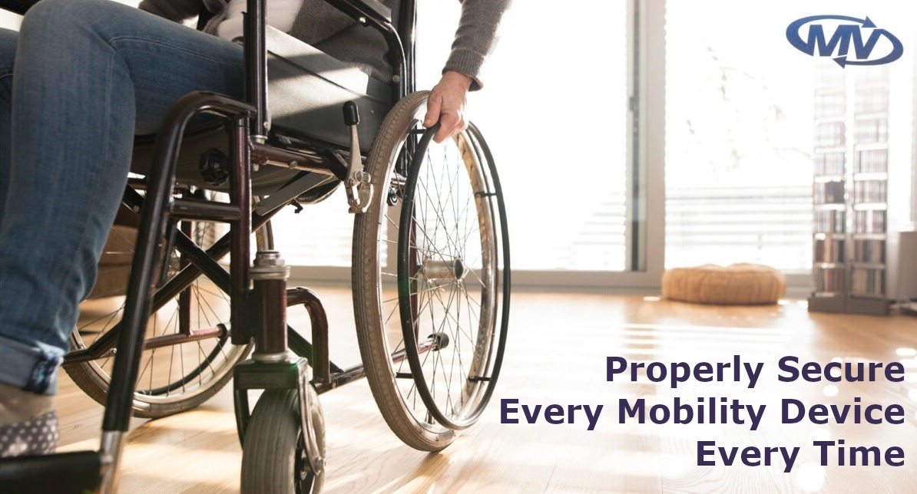
MV Transit Instruction History
Travel Instruction (TI) began in 1973 in New York as a program to aid students transitioning to secondary education from living with their parents. The program incentivized helping these students find employment, and transportation to said employment.
Travel Instruction began in King County in 1993 with Cares of Washington; they passed the contract over to LaidLaw, who passed it over to First Transit, and now this program is currently being supported by MV Transportation.

Slide 6
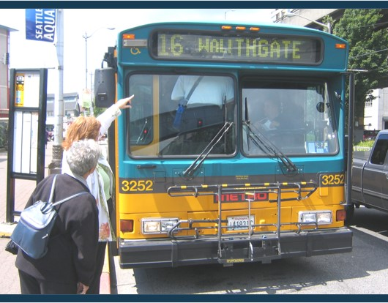
MV Transit Instruction
Available to community members 65 and older or people with a disability 14 years of age or older
Individual or group training is available
Provides freedom of movement and helps graduate people to become self sufficient and ride public transportation on their own
Includes Ramp Training and Systems Training

Slide 7
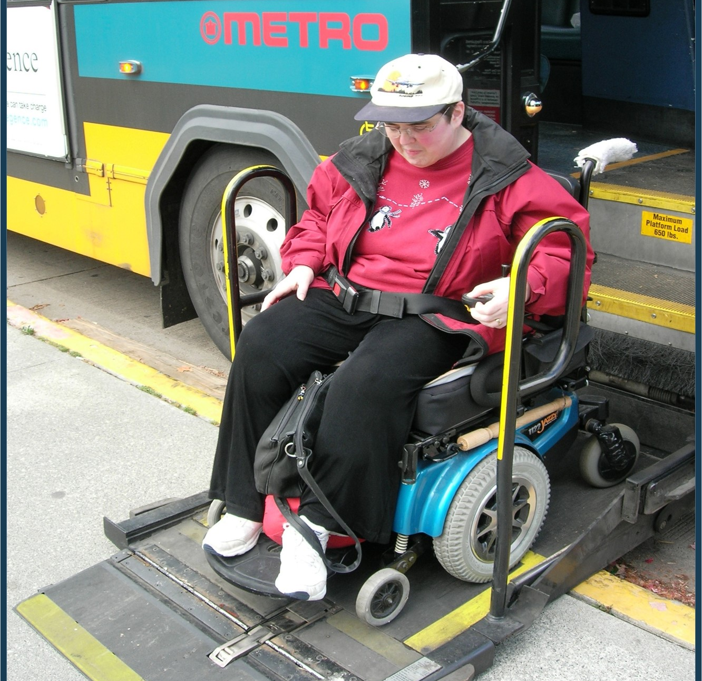
MV Transit Instruction: Points of Instruction
•Our goal is to provide our clients with the assistance and training needed to continue growing their world, not limiting it.
•We want to help our clients use public transportation so they can continue accessing the things that are important to them. From doctors' appointments to church to recreational or leisure activities.
•We take pride in going at each client's pace to ensure they will feel confident and safe before navigating public transportation on their own.

Slide 8
Transit Instruction Outreach Coordinator Christiana Williams Mobile: (253) 266-4130 christiana.williams@mvtransit.com
Questions & Answers

