Slide 1
Working with a disability
Disability Benefits
Jan Johnson Project Manager
Beth Pascarella Employment Specialist

Slide 2
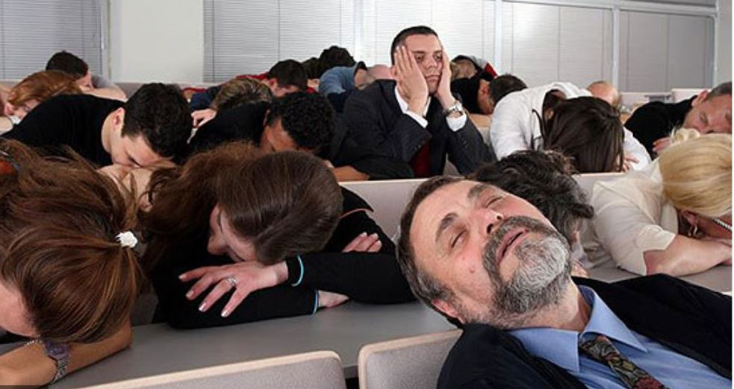
Let’s talk About benefits

Slide 3
Quick Overview
Two types of benefits: Supplemental Security Income (SSI) and Social Security Disability Income (SSDI)
Individuals can receive both at the same time.
Benefits are entirely different; they are two completely different government programs
They respond differently to employment, unearned income resources, living arrangements, etc.
They have different health insurance and different benefit amounts
There are different timelines associated with each

Slide 4
SSI vs SSDI
SSI
Need- based and means tested
* never/hardly worked
* have less than $2k in assets
SSDI
Based on previous work history
* the more you worked, the more you get
* No asset limit

Slide 5
SSI vs SSDI
SSI
Maximum amount for an individual of $914 (2023)
* if someone is reporting lower, they are probably getting deduction for child support or paying back an overpayment
SSDI
Benefit amount varies but higher than $914
*Individuals with a work history that is minimal and provides less than $914 may become concurrent (receive both).

Slide 6
SSI vs SSDI
SSI
Benefit varies depending on unearned income
* get an inheritance, win the lottery, get a job, the benefits check is cut fast
SSDI
Benefit is not impacted by unearned income
*SSA doesn’t care if you inherit a yacht – you paid into an insurance program and you get to keep your benefits

Slide 7
SSI vs SSDI
SSI
Benefit is cut the moment you go back to work
*you will lose a $1 in benefits for every $2 you make, and that doesn’t change when your income grows
SSDI
You get a magical year where you can keep all your benefit check and all your earnings
*this is called a Trial Work Period and a Grace period and there are lots of rules and some exceptions, but we are keeping this basic!
There are three favorable years that follow

Slide 8
SSI vs SSDI
A good way to tell whether your customer is receiving SSI or SSDI is to ask about medical benefits. Beware of self reporting – it is a good idea to check.
SSI
Medicaid
*This is the one area where the SSI people “win” since Medicaid covers more
*May have to purchase it at low rate at some point, but you don’t lose it by working. (1619b or HWD)
SSDI
Medicare
*Keep it for 9 years (after trial work period)

Slide 9
SSI vs SSDI Recap
SSI
Need- based and means tested
Maximum amount for an individual of $914 (2023)
Benefit varies depending on both earned and unearned income
Working impacts benefits immediately and consistently
Medicaid
SSDI
Based on previous work history
Benefit amount varies but higher than $914
Only impacted by employment; unearned income doesn’t matter
Working does not impact the benefits check right away – there is one magical year and 3 other favorable years that follow
Medicare

Slide 10
SSI vs SSDI Recap
SSI
People in poverty before they apply/disadvantaged
Disabled from birth, ex-offenders, unhoused
Hideously low amount
Stay in poverty
Relatively harsh when they go back to work
SSDI
Could be the soccer mom or the guy who used to run an IT company
Can be decent amount
Easy road back to work.

Slide 11
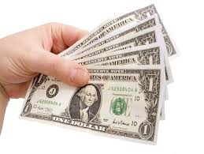
SSI – what happens when you return to work
SSI allows you to keep the first $85 of your benefit check and ½ of the remainder
If you make $1000
$1000 - $85 = $915
$915/2 = $457.50
You would end the month with $1,274.50
*you can deduct work expenses; up to $1,780 in earnings is not counted if in school

Slide 12
SSI breakeven point
At around $2000 of earnings in a month, your check will stop but will restart if earnings drop again.
, your check will stop.
You are still in the program and your check can resume when earnings drop

Slide 13
SSDI – what happens when you return to work
Keep everything for 9-12 months
Keep everything after that (for next 36 months) if earning under $1470, keep nothing from the check if earning over $1470. Each month evaluated independently.
Lots of rules (much more complicated than SSI) but lots of favorable outcomes
*Caution: simplified version of events

Slide 14
IS THIS EVER TRUE?
“I can only work part time because otherwise I will lose my benefits”
Other versions of this statement:
I can’t make more money because I would lose my benefits
I can’t accept the overtime hours because I would lose my benefits
I couldn’t help my boss on Sunday because I would lose my benefits
Etc…….

Slide 15
ANSWER: RARELY, BUT IT CAN BE TRUE
The only factual statements will be based on total monthly earnings (never on hours, part or full time, hourly wages, or overtime payments directly)
Total monthly earnings matter to SSDI beneficiaries after they finish their “magical year” (when they can earn anything and keep their check). For the three years afterwards, the total monthly earnings matter. These are still favorable years but checks come and go based upon monthly earnings.
Total earnings should never matter to SSI beneficiaries, because they are losing $1 for every $2 they make, and this never changes. There is no cliff to fall off.

Slide 16
IS THIS EVER TRUE?
“I can’t collect UI and SSI/SSDI at the same time
If I am collecting UI I am telling the government I can work, but if I am collecting disability benefits, I am telling the government I can’t work.

Slide 17
ANSWER: No
They are not incompatible because SSA has a different definitions of “work”.
To collect SSI/SSDI, you are saying you can’t work and make over a certain amount (“SGA”, currently $1410). To collect UI, you need to be looking for work at any earnings level.

Slide 18
Is this ever true?
Trying work will get me kicked off benefits. I can’t afford to lose my benefits so I better not try work.

Slide 19
Answer: Yes
This is where the Ticket Program is a critical safeguard. It is the back to work program run by SSA and you can’t get kicked off while you are in it.

Slide 20
Which benefit?
Your colleague becomes disabled and is unable to work. Which benefit would they likely be entitled to?
Your niece with celebral palsy has a disability benefit. Which benefit is she likely receiving?
Your customer keeps telling you they are receiving SSA disability benefits? How would you figure out which it is?

Slide 21
Your colleague receiving ssdi is now ready to return to work
They can:
Kiss that benefit check goodbye
Kiss part of their benefit check goodbye
Enjoy a magical year of benefits and wages, and then have three more years with a huge “safety net” of benefits

Slide 22
Your Niece receiving ssi is now ready to Try work
They can:
Kiss that benefit check goodbye
Kiss part of their benefit check goodbye
C) Enjoy a magical year of benefits and wages, and then have three more years with a huge “safety net” of benefits

Slide 23
What to do to help your customers?
Co-enroll with Ticket to Work
TTW offers benefits counseling and benefits protection
We are SeaKing WDC’s Employment Network (subcontracted to Pacific Associates)
Jan Johnson: jjohnson@pacassoc.com
Beth Pascarella: bpascarella@pacassoc.com

