Slide 2
Community Living Connections is a network of providers , that can connect individuals with the right kind of help, when and where you need it. Older adults, adults with disabilities, caregivers, family members and professionals can call us to get objective, confidential information about community resources and service options.
https://www.communitylivingconnections.org/

Slide 3
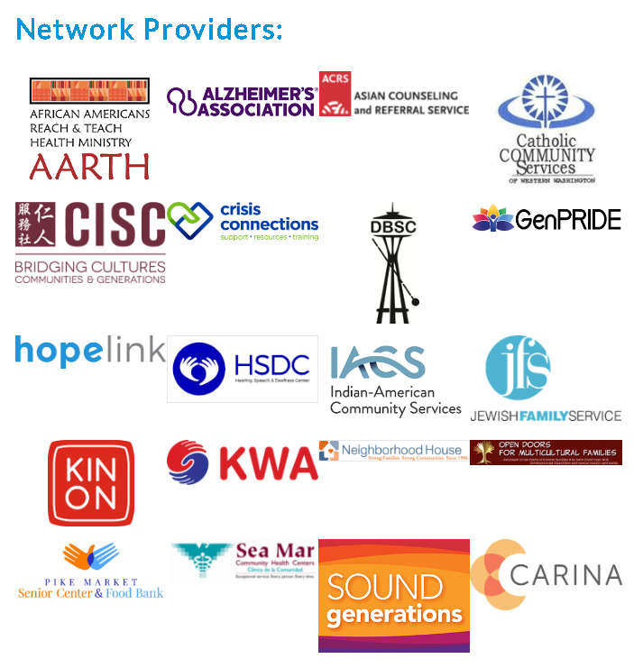

Slide 4
Zoom & Meeting Tips
Video is not mandatory
Mute if you are not speaking
Questions through out the meeting can be put into the chat box
When in breakout rooms, if your comfortable please have video on
Powerpoint slides will be sent after meeting on the CLC website

Slide 5
Agenda
10:00-10:10 AM: Introductions /CLC Overview
10:10-10:30 AM: Pacific Associates – Ticket to Work, Jan Johnson – Project
Manager
10:30-10:50 AM: King County Metro’s Transit Instruction Program, Christiana
Williams – Outreach Coordinator
10:50-11:00 AM: Breakout Rooms – Networking, Name, Role, Agency, and how we
can help each other.
11:00-11:20 AM: Homage AmeriCorps Senior Companion Program, Deborah
Gurney – Manager & Mary Ann Higgins – Senior Companion
Program Coordinator
11:20-11:40 AM: Valley Medical Center – Volunteer Health Coach Program, Janitsa
Dolan – Health Coach Program Social Worker
11:40-12:00 PM: Job openings, ADS updates, announcements, questions and
resources

