Slide 1
What is a Clubhouse?

Slide 2
An Accredited Clubhouse
A place where people with serious mental illness participate in their own recovery process by working and socializing together in a safe and welcoming environment
Clubhouses offer people living with mental illness hope and opportunities for a successful and fulfilling life
An Accredited Clubhouse operates on proven, evidence-base, standards developed by Clubhouse International.
The model has been around for 75 years and is effective in over 340 Clubhouses in 35 countries world-wide.

Slide 3
A Clubhouse is NOT:
A traditional day treatment program with classes that operate all day. This model gives those attending one choice only and by contrast, a Clubhouse provides an array of choice and opportunity in work units.
A program run by staff in which members are passive participants. By contrast, members run unit meetings and take on leadership roles in all activities
A place where there are staff only spaces such as staff offices, bathrooms or other separated spaces. All space is shared.
A Clubhouse is NOT

Slide 4
Characteristics of a Clubhouse
Membership is voluntary and lifelong.
Members have a key role in organizing Clubhouse activities.
Staff and members work together as colleagues.
Work and social activities in the Clubhouse are meaningful and restorative helping members regain self-worth, confidence and purpose.
Clubhouses operate on the belief that every member can recover from the effects of mental illness and maintain a personally satisfying life.
All members, even those struggling with the most severe symptoms can contribute to the work of the Clubhouse.

Slide 5
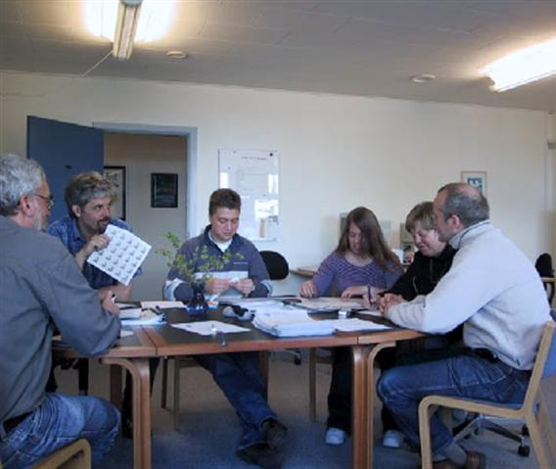
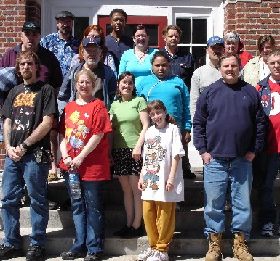
Members Reclaiming Their Lives
Clubhouse participants are known as “members”.
It is a community-based approach that complements available psychiatric treatment and services by working alongside community partners and providers as a “member based” integrative approach to treatment.

Slide 6
Together we can create communities that promote recovery.
Continuity of Care
Enhanced social & occupational supports
Recovery & Treatment options
Wrap around care
Decreased isolation
Increased participation in integrative care
When Clubhouses, Providers and Community Partners come together, we create opportunities for our clients/members to recover through:

Slide 7
Clubhouses are:
Holistic – offering members opportunities for socialization, friendship, employment and education. As well as assistance in accessing, acquiring and keeping affordable and dignified housing, medical and psychiatric services. All through a single caring and safe environment.
Inclusive – allowing members to meet and follow the example of others
Sustaining – Creating a safe and stable environment to provide a foundation for growth and achievement allowing members to reach their goals over the course of their life and be productive members of society
Responsive – dedicated to continuous improvement based on direct feedback from members.
Cost-Effective – providing members, families and communities significantly more value for money than other approaches.

Slide 8
Clubhouses address the social determinants of a healthy life
Connectedness: A place to belong
Access to and help with needed social services
Safe, stable housing
Supported Education
Employment (avoiding poverty)
Access to and help with participating in quality healthcare
Promoting wellness and healthy lifestyles
Friendships and a social network

