Slide 1
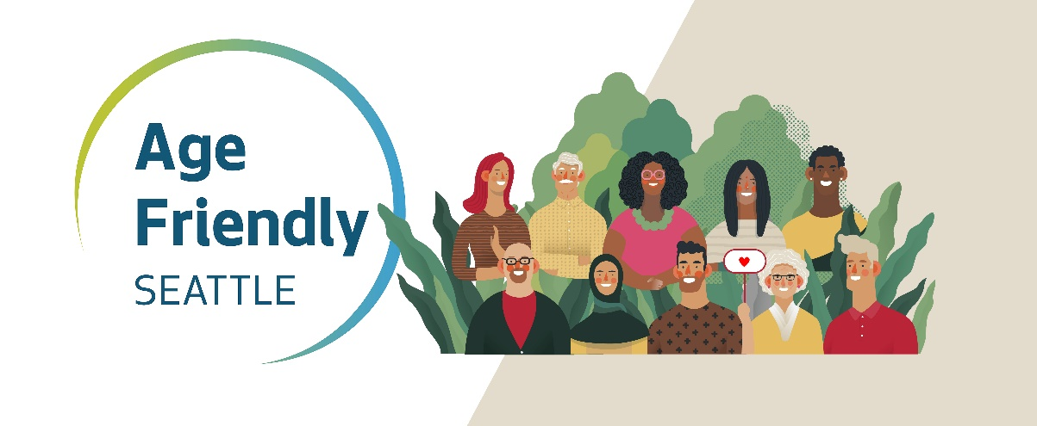
Age Friendly Seattle
Community Living Connections Network Meeting
Notes:
Dinah Dinah - MOSC was a physical location and operated as a direct service provider. It relied upon older adults physically coming in to ask for services/resources/etc.
As capacity grew at community-based organizations, Seattle shifted away from this model and towards a “supportive partner” role. Age Friendly Seattle was born out of this transition and operates as an entity that helps provide service coordination, training, systems development work, and outreach. Housed within HSD/ADS, we are like a mini advocacy shop whose job it is to make sure the needs of older adults are understood and prioritized– both internally at the city, as well as externally.

Slide 2
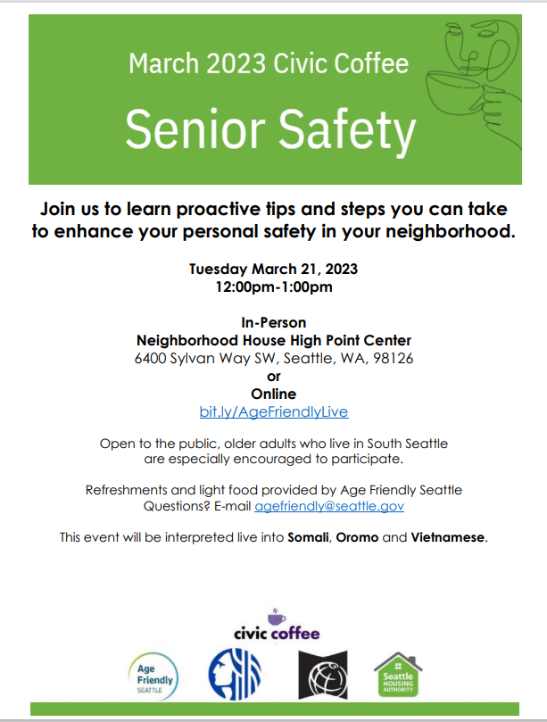
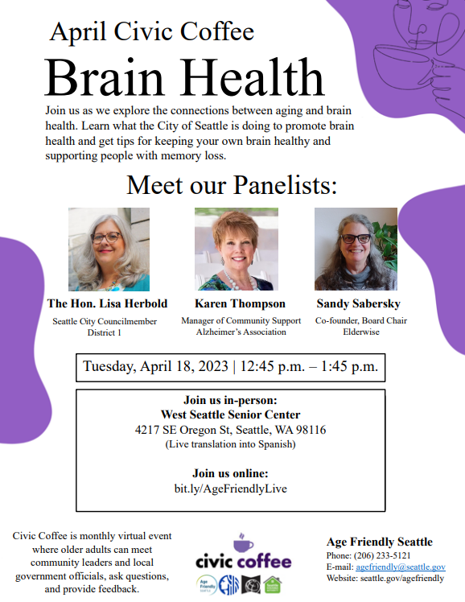
Civic Coffee Hour
Notes:
Eldad

Slide 3
Gold/FLASH Cards
GOLD: age 60+
FLASH: age 18-59 with disabilities
Discount Directory online
Attractions, services, retail businesses, programs to save $, etc.
Help support...
social interaction
affordability
increased awareness
Notes:
Meg

Slide 4
Discount Directory
Search for discounts:
By Business/Organization name
Category
Zip code
City
etc.

Slide 5
Types of Discounts (a sampling!)
Attractions
Aquarium 100% off
Woodland Park Zoo 75% off
Seattle Art Museum $5 only
Businesses
OnePlus Kitchen & Home 20% off
Momosan Ramen 10% off
T-Auto Repair 20% off
Urban Feed & Garden 10% off
The Polytech 10% off
Snapdoodle Toys 10% off
and much more...
Programs (free or reduced cost)
Regional Reduced Fare Permit (RRFP)
Sound Steps (Parks & Recreation)
WA Connection
One Step Ahead Fall Prevention Program
Trees for Neighborhoods
TechConnectWA
Community Living Connections, etc.

Slide 6
How to connect to this work?
Request bulk cards for clients
Add value to your own efforts
Recommend programs​
Know of free/reduced cost programs for older adults and people with disabilities?​
Let us know!
Help solicit businesses!​
Tell favorite local business/restaurant about directory​/Request invitation cards
Can sign themselves up online—takes 5 mins!
Notes:
Meg

Slide 7
Thank you!
Questions?

Slide 8
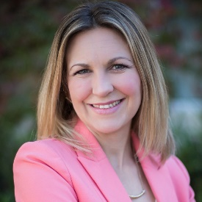
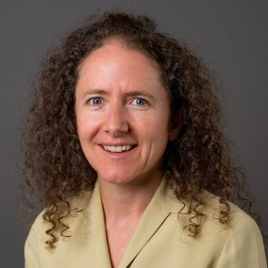
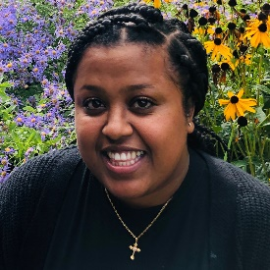
For More Information
Dinah Stephens
Age Friendly Seattle
Program Manager
Dinah.Stephens@seattle.gov
Meg Estep Woolf
Age Friendly Seattle
Program Coordinator
Meg.Woolf@seattle.gov
Eldad Mekuria
Age Friendly Seattle
Program Coordinator
Eldad.Mekuria@seattle.gov
Notes:
Reach out!

