Slide 1
Geriatric Regional Assessment Team
(GRAT)
Notes:
Thank you for the invitation to speak today!
Introduction: 7 years at Harborview,
OG: Clinician
Almost 30 years in social work: just about getting the hang of it.

Slide 2
Brief History
Hosted by Evergreen Health through 2017
Re-funded by King County in 2020 through the Veterans, Seniors, and Human Services Levy (VSHSL) and MIDD Behavioral Health Sales Tax
Sound Generations was awarded the contract

Slide 3
GRAT Past and Present
Age eligibility
Role in community response
Staff complement
Outreach

Slide 4
GRAT Today
GRAT serves older adults who are escalating toward crisis, with behavioral health, or substance use issues, or memory loss
GRAT offers outreach, comprehensive assessment and early intervention with the goal of stabilizing clients in their homes
Notes:
East African woman in her 60’s referred by MCT due to hearing voices keeping her up at night. She lives alone as her family caregiver was no longer available.
75 year old African American woman is in early stages of dementia, and has been wandering off to downtown Seattle. Client is delusional and believes her children have been stolen, and people are after her. Client lives with her daughter, who is unsure of how to continue supporting her and keep her safe.

Slide 5
Examples of GRAT Interventions
Refer to community mental health
Link to medical staff for further diagnosis and treatment
Rally family or others in social circle
Refer for transportation and support resources
Educate families about caregiver support
Advocate for client’s rights
Refer to APS for older adults at risk
Notes:
Refer to community mental health or private therapist through an agency such as Mindful Therapy Group, considering language, race, culture, gender identity. Examples might include linkage to ACRS or Consejo.
Link to medical staff for further diagnosis and treatment. Kaiser example with voices, Harborview example with Covid fear.
Rally family or supportive others in elder’s informal resource network to increase care and safety. Nephew from Spokane coming for a digout, Cousin from Germany asking for a check in, Brother from Iowa asking for help
Referrals to support services such as transportation, socialization, and meals
Educate families about caregiver support resources; e.g., Alzheimer’s Association support groups. Provide information to families about respite services, hiring caregivers privately vs. Medicaid based in home services
Advocacy: double amputee living on the fifth floor in a housing entity that is marketed to older adults

Slide 6
Who to Refer
Isolated adults 55 and older residing in King County
Struggling with cognitive, behavioral, mental health or substance use issues
Escalating toward a crisis
Risk of hospitalization
Risk of losing housing
Living in unhealthy environments
Limited community and family support
Notes:
Who Makes Referrals
Emergency providers
Family, Friends, or Neighbors
Primary Care Physicians
Social Service Providers
(206) 448-5730
GRAT@soundgenerations.org

Slide 7
Who Not To Refer
GRAT does not accept:
Suicidal or homicidal older adults with plan and intent
Those already served by behavioral health programs
Older adults in Assisted Living Facilities, Adult Family Homes, or Skilled Nursing Facilities
Unhoused older adults
Notes:
Not every referral is accepted
The crisis merited DCR involvement
Duplication of services
Client has been previously served, with no new changes
Ineligible due to medical acuity or current hospitalization

Slide 8
How To Refer
Contact
(206) 448-5730
Email: GRAT@soundgenerations.org
Fax: (206) 737-0375
Notes:
Phone is live answered Monday through Thursday, 9 AM to 5 PM.
No protected information in email, please.

Slide 9
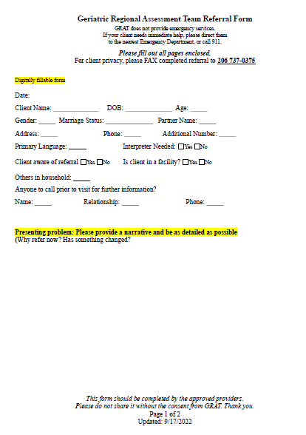
Referral Tips
Notes:
Just a two page referral form. Must have a MH, substance use or memory loss aspect to the referral.
The detail you add is important!
to have a better chance to connect with the client
to share your view of the issues observed
to protect a clinician providing an outreach

Slide 10
Referral Tips

Slide 11
Referral Tips
Notes:
Client does not need to approve referral

Slide 12
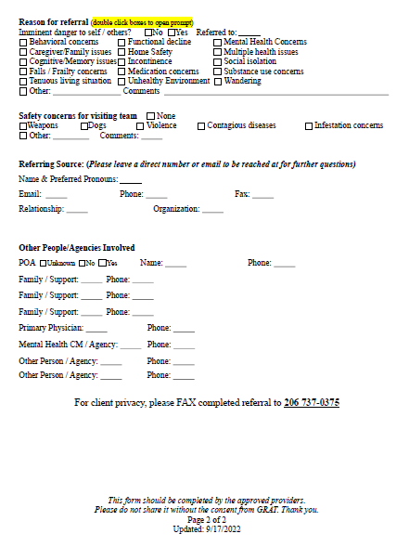
Referral Tips

Slide 13
GRAT serves all of King County
Monday – Friday 9 AM to 5 PM
Referrals are accepted or declined within 3 business days of receipt
Accepted clients are contacted within 1-5 business days
GRAT intervention is short-term, with the goal of linking clients with longer-term stabilizing resources
GRAT Clinicians utilize telephone interpreters when needed
No cost to client for GRAT services

Slide 14
Contacts
GRAT Clinical Supervisor – Robin Nelson
(206) 450-1518
robinn@soundgenerations.org
Pathways Information and Assistance:
(206) 448-3110 or 1-888-435-3377

Slide 15
Questions?

Slide 16
Thank you!

