Slide 1
Adult Day Health
September 21, 2022
April Hamilton, Program Director
Stacy Christ, Program Development Director

Slide 2
Small Miracles. Extraordinary Lives. Mission: Full Life is dedicated to enhancing the quality of life for frail elders and people with chronic or terminal illnesses and disabilities. We are committed to the independence and well-being of all participants and to providing respite for caregivers. Vision: We are working toward a future where adults with serious illnesses or disabilities can be supported in the community rather than living in isolation or needing to resort to institutional care.

Slide 3
Full Life Care Programs
Adult Day Health
Health Home
Home Care
Housing Services and Supports
ElderFriends Volunteer Companionship
NEW! Volunteer Care Teams

Slide 4
Adult Day Health
Supports the independence of older adults and people with chronic illnesses and disabilities who wish to continue living in their community
Skilled nursing and occupational therapy services
Therapeutic activity groups, case management, transportation, and meals are provided
Center located in Colombia City
Funding
Notes:
What is ADH? - All of our programs are focused on supporting the independence of older adults and people with chronic illnesses and disabilities who wish to continue living in their community. We support our clients and their families by providing services to aid in managing chronic health conditions, maintaining or improving functional mobility, offering respite for caregivers, and activities to prevent social isolation. Our multidisciplinary teams are made up of nurses, occupational therapist, social workers, and case managers. Transportation and meals are provided in our programs as well for in-person programming. During the COVID-19 pandemic we have moved all our services to virtual and we are currently in the process of slowly reopening our Everett and Colombia City locations.
Funding
We have several different funding sources to pay for care such as COPES, MAC/TSOA, Veterans Administration, Family Caregiver Support Network, SCSA Senior Citizen Services Act, Private Pay, there are also some LTC insurance policies that cover ADH.
Participants work with skilled rehabilitative and nursing therapies to improve physical, social and cognitive functioning. Nurses provide skilled services such as- Head to toe assessment, BG checks & insulin admin, BP checks, CHF monitoring, tube feeds, ostomy care, foley care, med admin, wound care, and CARE COORDINATION
Nursing services:
- Head to toe assessment
- BG checks & insulin admin, BP checks, CHF monitoring, tube feeds, ostomy care, foley care, med admin, wound care, and CARE COORDINATION
OT services:
- ADL training, fall prevention work, DME procurement, AD fitting, exercises… and problem-solving all sorts of situations and scenarios

Slide 5
Our Clients
Where they live: Adult family homes, assisted living facilities, or private homes.
Who cares for them: Paid caregivers, family caregivers, or are on their own at home.
Conditions they live with: Dementia, brain injury, major neurocognitive disorders, developmental delay, multimorbidity, various chronic conditions, etc

Slide 6
Eligibility
Adults ages 18+
Reside in King County
Unmet skilled nursing or rehab need
Maintain in a group setting (do not need 1:1 care)
COVID-19 vaccinations
Notes:
Unmet skilled nursing or rehab need that can’t be managed in a lower level of care setting

Slide 7
Typical Schedule
8:30 – 9:00– Clients Arrive
9:00 - 9:45 – Cognitive Group
9:45 – 10:30 – Exercise
10:30 – 11:45 – Active Group
11:45 – 12:45 – Lunch
12:45 – 1:15 – Clients Depart
Virtual Programming
Notes:
RN/OTs will pull clients for skilled care during groups.
Cognitive Groups – Chronic Disease Self Management, Brain Games, art, trivia
Exercise – Stay Active and Independent for Life (SAIL) evidence based exercise program
Active Groups – modifed yoga, tai chi,
We are still offering virtual ADH which includes wellness calls, care coordination, caregiver support, individualized exercise plans, and Zoom group activities

Slide 8
Referrals
Website: https://www.fulllifecare.org/contact-us/information-request-form/
Intake Coordinator: Olivia Jokumsen
Email: oliviaj@fulllifecare.org
Phone: (206) 889-8394
Notes:
When referring please send 10-580 form along with the client most recent state assessment and service summary.

Slide 9
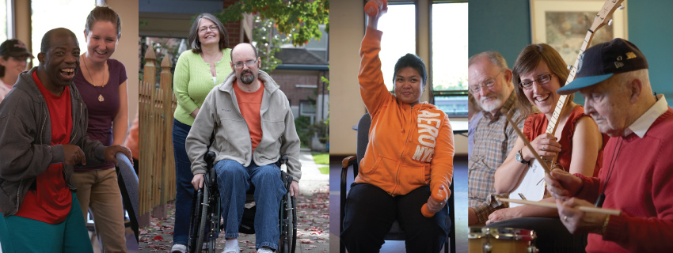
Thank you! Questions?

Slide 10
Contact
April Hamilton - Director of Adult Day Health
Email: April.Hamilton@fulllifecare.org
Ph: 206.595.7915
Stacy Christ- Adult Day Health Program Development Director
Email: Stacyc@fulllifecare.org
Ph: 206.496.7332

