Slide 1
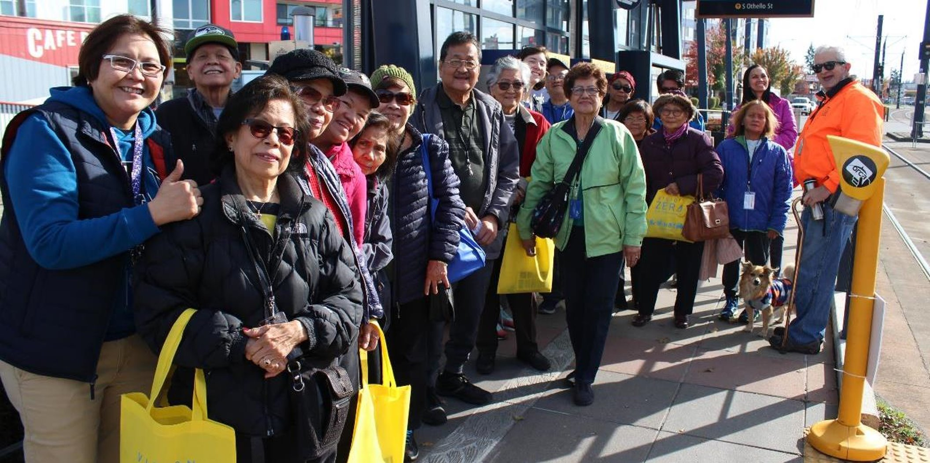
Ride Now
Overview
Community Living Connections Network
Margo Iñiguez Dawes

Slide 2
Our vision, mission, and core values
Vision: Seattle is a thriving equitable community powered by dependable transportation
Mission: Deliver a transportation system that provides safe and affordable access to places and opportunities
Committed to 6 core values:
Equity
Safety
Mobility
Sustainability
Livability
Excellence

Slide 3
Background
Ride Now
65+ or disabled?
Get an accessible, affordable ride when you want it.
No reservations required.
Ride Now pilot launching in March
Purpose: Provide accessible, affordable short trips for older adults and people with disabilities
Mechanism: $15-20 ride vouchers to Yellow Cab, Uber, and Lyft
Design: Guided by a compensated steering committee of 7 individual stakeholders, 3 partner organizations, and several project advisors
Also received 400+ responses to a stakeholder survey in the fall
Scope: Short-term, small-scale pilot (only running March-May, $55k total for ride vouchers)
Funding: Federal grant from Transit Planning 4 All

Slide 4
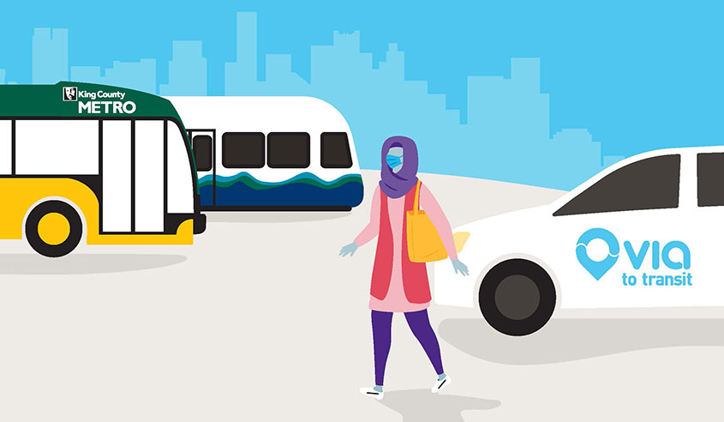
More context
Pilot goals:
Inclusively plan and pilot a mobility on demand service by and for older adults and people with disabilities
Convenient, accessible, affordable
See if we can offer something like Via citywide using multiple (non-dedicated) providers
Determine demand
Test low-barrier sign-up
Distribute primarily through “warm connections” (existing relationships)
Inform future programming
Frequently asked question: “Is this like Via to Transit?”
Answer: Yes!

Slide 5
How it’s going to work: Requesting vouchers
A rider…
1. Hears about the pilot
2. Requests vouchers through webform or by calling 684-ROAD
3. Receives their vouchers by email or mail
4. Uses their vouchers
5. Provides feedback (encouraged)
6. Requests more vouchers (optional)

Slide 6
Step 2: Request form
Name
Eligibility (older adult (65+), person with disability, and/or caregiver)
Access needs
Wheelchair accessible vehicle
Need to book ride by phone
Need to pay remaining balance in cash
Preferences
Paper vouchers by mail
Digital promo codes by email
Uber or Lyft
Driver/access to car
Contact info
Optional demographic information
Age
Type of disability
Race/ethnicity
Employment status
Household income

Slide 7
Step 4: Using vouchers

Slide 8
Request for this group
Feedback and questions
Help spreading the word to your clients/potential riders
If this is an especially good fit for the people you work with, consider becoming a distribution partner

Slide 9
Questions?
Margo Iñiguez Dawes | Margo.Iniguez-Dawes@seattle.gov
Kiana Parker | Kiana.Parker-C@seattle.gov
Lizzie Moll | Lizzie.Moll@seattle.gov
http://www.seattle.gov/transportation/projects-and-programs/programs/inclusive-planning-for-mobility-on-demand

