Slide 1
VSHSL PRESENTATION FOR COMMUNITY LIVING CONNECTIONS
June 11, 2019

Slide 2
WELCOME AND INTRODUCTION
Traci Adair – Program Manager
Nikki Nguyen – Program Specialist
Virginia Weihs – Program Specialist

Slide 3
POP QUIZ
Question: What does VSHSL stand for?
Answer: Veterans, Seniors, Human Services Levy

Slide 4
POP QUIZ
Question: What are the three priority populations served with the Levy money?
Answer: Veterans, Servicemembers & their Families, Seniors (55+) & their Caregiver, Vulnerable Populations

Slide 5
POP QUIZ
Question: What is the estimated amount of annual funding allocated for these three populations?
Answer: About: 55 - 65 million dollars

Slide 6
VSHSL
Veterans, Seniors and Human Services Levy details:
Passed by King County voters in 2017
6-year property tax levy (Jan. 2018 – Dec. 2023)
10¢ per $1000 assessed value, ~$55-65M annually
Replaces the former Veterans and Human Services Levy
VSHSL Implementation Plan passed 2018
Informed by continuous community engagement
Veterans (servicemembers & families)
Seniors
(55+) and caregivers
Vulnerable Populations
SERVICES IN 5 RESULT AREAS FOR 3 PRIORITY POPULATIONS
Housing Stability
Financial Stability
Social Engagement
Healthy Living
System Access & Improvement

Slide 7
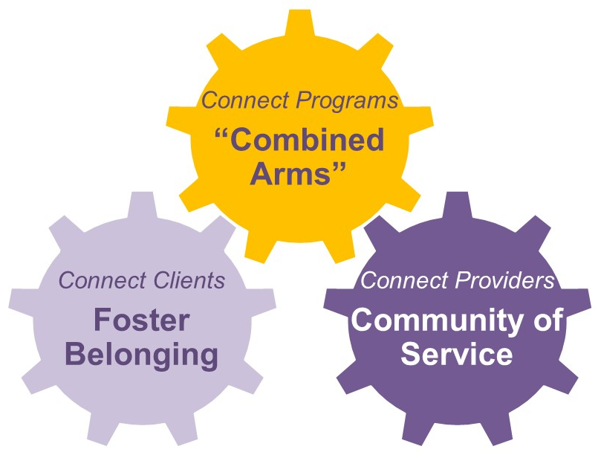
VSHSL
Guiding Principles
Connection
Belonging
What can only the VSHSL do?

Slide 8
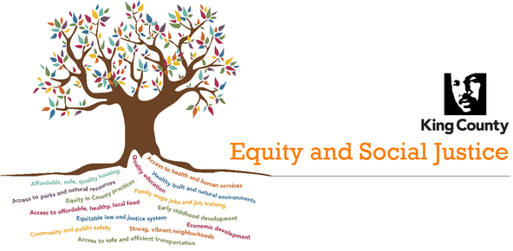
EQUITY AND SOCIAL JUSTICE
King County is leading with race in our commitment to Equity & Social Justice
Equity and Social Justice (ESJ) is an integrated part of the County’s work and foundational to the work of the VSHSL.
Our goal is to ensure that all people have the opportunity to thrive, with full and equal access to opportunities, power, and resources.

Slide 9
HUB MODEL
Veterans Hub
A Connected Service System: Combining Arms through Hubs
Human services investments are more effective and efficient when connected. The Veterans, Seniors and Human Services Levy (VSHSL) takes a combined arms approach by making thoughtful combinations of programs available through a system of hubs in which the programs amplify their mutual effects and mitigate each other’s weaknesses. Our goal is to better connect individuals to services and providers to each other.
Three Hubs for Three VSHSL Populations:
Veterans Hub: The King County Veterans Program will serve as a new hub for multiple levy-funded services. Together, this will strengthen our ability to support veterans, servicemembers, and their families.
Seniors Hub: Senior centers and virtual villages will serve as hubs of service for our seniors and their caregivers.
Vulnerable Populations Hub: Program hubs will connect and empower vulnerable populations. We will also invest in connectivity itself, through a consolidated domestic violence hotline and outreach teams.
Seniors Hub
VSHSL
VSHSL
Veterans Hub
Vuln. Pops Hub

Slide 10
SENIOR INVESTMENTS
Strategy | Program | Total funding 2019 - 2023
HS 3B | Adaptive Devices, Training & Counseling (2019) | $ 1,560,000
FS 2 | Promote Financial Literacy (Seniors) | $ 1,700,000
SE 2A | Caregiver Community Building (2020) | $ 2,520,000
SE 2B | Caregiver Respite (2020) | $ 2,430,000
SE 2C | Kinship Care Supports (2020) | $ 950,000
SE 3 | Transform Senior Centers (2019) | $ 20,650,000
SE 4A | Senior Virtual Villages (2020) | $ 2,625,000
HL 1A | Senior Depression Intervention/PEARLS (2019) | $ 1,945,000
HL 1H | Geriatric Regional Assessment Team (2019) | $ 1,600,000
HL 2A | Evidence-Based Senior Health Promotion (2020) | $ 6,900,000
HL 2C | Mobile Meal Delivery for Seniors (2020) | $ 1,600,000
HL 2D | Connections to In-Home Care (2019) | $ 2,150,000

Slide 11
DEFINITIONS
Caregiver: Family member or friend who supports an older adult, but is not provided payment for providing those services.
Senior: A person who is age 55 yor older.
Senior Hub: A senior center or set of partnering senior centers with the staffing, programmatic, and systems capacity to serve as the recognized resource center on aging services and supports for a focused geographic area and/or specific cultural group(s).
Servicemember: A person currently serving in a branch of the military, including the National Guard and reservists for any branch of the military.
Veteran: A person who has served as either an active duty or a reservist member of the US Army, Navy, Marines, Air Force, or Coast Guard; or a person who has served in the National Guard.
Vulnerable Population: Those persons or communities that are susceptible to reduced health, housing, financial or social stability outcomes because of current experience of or historical exposure to trauma, violence, poverty, isolation, bias, racism, stigma, discrimination, disability or chronic illness.

Slide 12
VSHSL & CLC
Mutual Referrals
Collaborative Learning
Sharing of Resources
Trainings and Educations
Let’s Keep Talking….

Slide 13
Q&A

Slide 14
Contacts
Traci Adair, OAHA Program Manager: 206.263.3027 tadair@kingcounty.gov
Virginia Weihs, OAHA Program Specialist: 206.263.9102 vweihs@kingcounty.gov
Nikki Nguyen, OAHA Program Specialist: 206.263.3442 nnguyen@kingcounty.gov

