Slide 1
Health Promotion Program
Connecting Diverse Communities with Health & Nutrition
Tanya Fink, MS, RD
Georgina Sanchez, MS, RD
Carly Renner, MS, RD

Slide 2
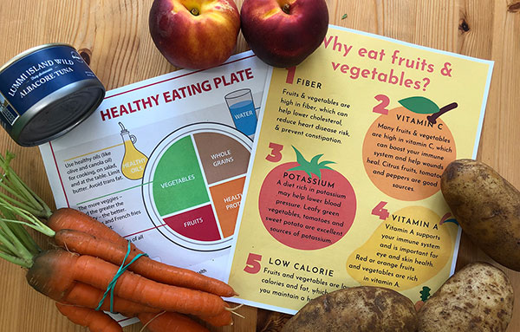
Notes:
https://www.agewisekingcounty.org/publications/agewisekingcounty/september-2021/connecting-diverse-communities-with-health-and-nutrition/

Slide 3
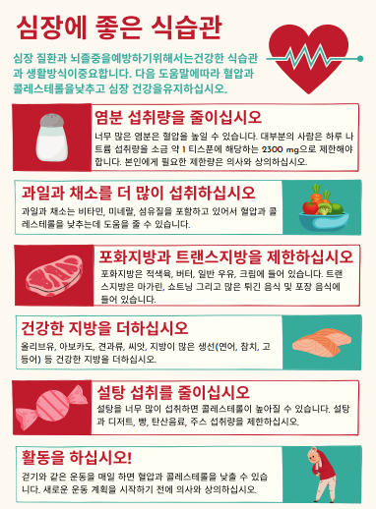
Nutrition Education Topics:
Bone Health
Diabetes
Importance of Fruits & Vegetables
Balanced Plate
Heart Health
Hydration
Hypertension
Immune Support Nutrition
Food Safety
Portion Sizes
And more!

Slide 4
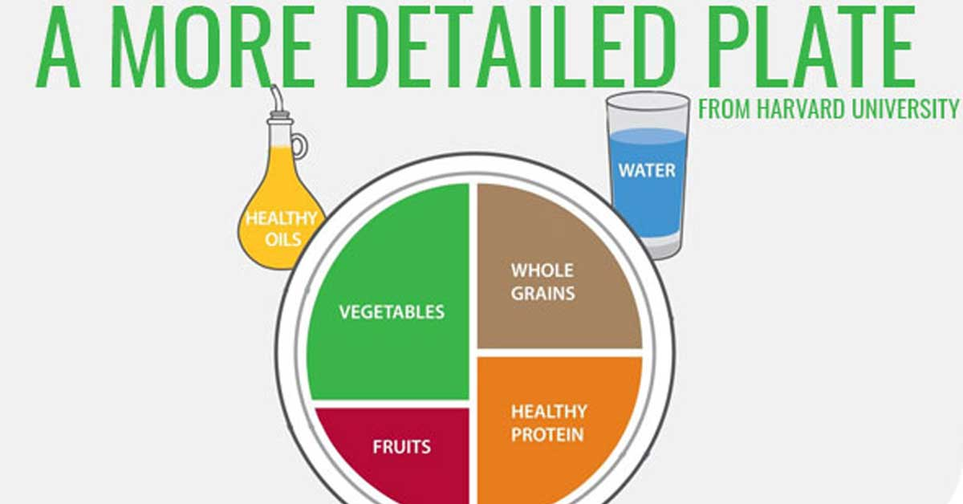
As of August 2021, materials have been translated into more than 12 languages and have reached 743 participants in Seattle
Protein options: eggs, canned fish, lentils, beans
Starch options: potatoes, sweet potatoes/yams, oats, corn, wheat berries, buckwheat, barley, millet, rye
Notes:
257 bags available

Slide 5
Contact us at:
Tanya Fink, MS, RD
TanyaFink@Tilthalliance.org
Georgina Sanchez, MS, RD
GeorginaSanchez@Tilthalliance.org

