Slide 1
Volunteer Transportation VTS
One of the many great programs at Sound Generations (SG)
By
Crystal Jones, Volunteer Transportation Coordinator

Slide 2
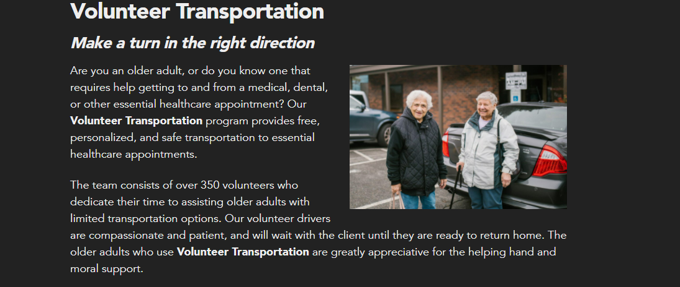
About Our Program

Slide 3
Helpful Acronyms and Stuff
Volunteer Transportation (VTS)
Sound Generations (SG)
Driver Companion Program (DCP)
Ride Scheduler (RS)
Salesforce (SF)
High Priority (HP)
Teleintepreter (TP)
Notes:
Cancelled (CXL)
Unknown Times (11:11)

Slide 4
Program Requirements

Slide 5
Setting an Appointment

Slide 6
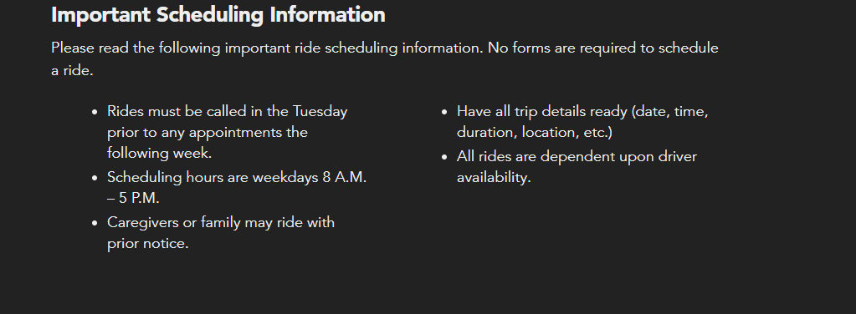
Helpful Tips

Slide 7
Want to Financially Affect Change?
Donations can be made in three ways, online, over the phone, or through the mail
Drivers have donation envelopes, or they can be mailed to you
SG has a donation button on the site, please specify the department

Slide 8
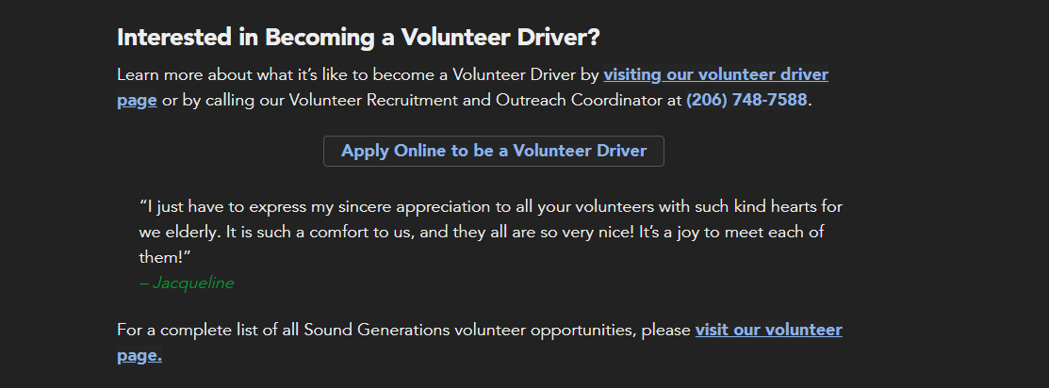
Ready to Serve?

Slide 9
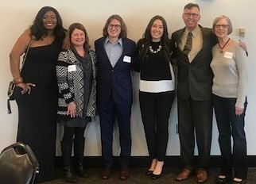
The Old Team

Slide 10
Point of Contact (POC) aka The New Team
VTS Email (Group Email) vts@soundgenerations.org
Crystal (VTS) crystal@soundgenerations.org
Erin (VTS/Hyde) erinh@soundgenerations.org
Francis (VTS/Hyde) francisc@soundgenerations.org
Karen (VTS/Hyde) karenc@soundgenerations.org
Linda (VTS) lindap@soundgenerations.org
Arleen (VTS) arleenn@soundgenerations.org
Val (VTS/Hyde) valeried@soundgenerations.org

Slide 11
Q & A
Comments, thoughts, compliments?

