Slide 1
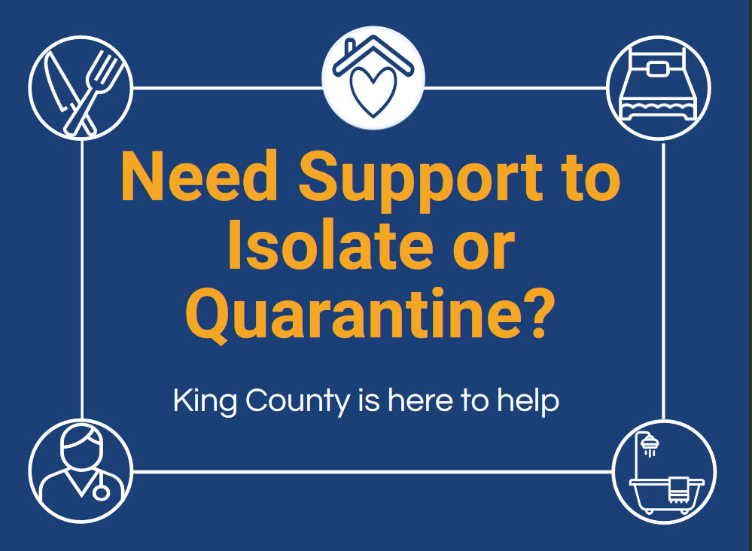
Notes:
We translated and trans-created the I&Q resources into over a dozen languages, crafted talking points, and presented on I&Q to dozens of representatives (“Community Navigators”) from diverse communities in King County. Community Navigators then distributed these resources and information amongst their networks. We distributed resources on I&Q to hundreds of healthcare providers with particular attention to reaching diverse, limited English-speaking patients

Slide 2
Notes:
Info in 10 languages

Slide 3
https://www.kingcounty.gov/depts/health/covid-19/languages.aspx

Slide 4
FOR PEOPLE WHO NEED A PLACE TO ISOLATE/ QUARANTINE
Isolation & Quarantine Centers
King County has safe places for temporary isolation, quarantine, and recovery from COVID-19
About Isolation and Quarantine (I&Q)
A proven public health practice for reducing the spread of disease
Quarantine is for people who have been exposed to an infectious disease and could become sick and then spread the infection to others.
Isolation is used for people who are currently ill and contagious, and who need to stay away from others in order to avoid infecting them.
Isolation or quarantine at a King County facility does not mean you will be alone- a care team of nurses and behavioral health providers will check in on patients daily and ensure their needs are met.

Slide 5
FOR PEOPLE WHO NEED A PLACE TO ISOLATE/ QUARANTINE
Individuals can self-refer for isolation if you are:
Confirmed COVID-19 positive; OR
Have new COVID-like illness; OR
Got tested for COVID-19 and are waiting for results
AND
Are unable to safely isolate at home
Do not have a separate bedroom where you can recover without sharing immediate space with others; OR
Do not have a home (or victim of domestic violence actively attempting to flee)

Slide 6
FOR PEOPLE WHO NEED A PLACE TO ISOLATE/ QUARANTINE
COVID-19-like illness (CLI) may be defined as any of the following:
Fever or chills
Cough
Shortness of breath or difficulty breathing
Fatigue
Muscle or body aches
Headache
New loss of taste or smell
Sore throat
Congestion or runny nose
Nausea or vomiting
Diarrhea
https://www.cdc.gov/coronavirus/2019-ncov/symptoms-testing/symptoms.html

Slide 7
FOR PEOPLE WHO NEED A PLACE TO ISOLATE/ QUARANTINE
Individuals can self-refer for quarantine if you
Do not have symptoms, but recently had close contact with a person with COVID-19*
AND
Are unable to safely quarantine at home
Are unable to stay away from household members who are at higher risk for getting very sick from COVID-19; OR
Do not have a home (or victim of domestic violence actively attempting to flee)
Close contact includes:
Living in the same household as a sick person with COVID-19
Caring for a sick person with COVID-19
Being within 6 feet of a sick person with COVID-19 for a total of 15 minutes in 24 hours, OR
Being in direct contact with secretions from a sick person with COVID-19 (e.g., being coughed on, kissing, sharing utensils, etc.)
* You do not need to quarantine if you have been fully vaccinated

Slide 8
FOR PEOPLE WHO NEED A PLACE TO ISOLATE/ QUARANTINE
People at higher risk for severe illness include:
Individuals over 65 years of age
People of all ages with underlying medical conditions, particularly if not well controlled, including:
People with chronic lung disease or moderate to severe asthma
People who have serious heart conditions
People who are immunocompromised.
Many conditions can cause a person to be immunocompromised, including cancer treatment, bone marrow or organ transplantation, immune deficiencies, poorly controlled HIV or AIDS, and prolonged use of corticosteroids and other immune weakening medications
People with severe obesity (body mass index [BMI] of 40 or higher)
People with diabetes
People with chronic kidney disease undergoing dialysis
People with liver disease
https://www.cdc.gov/coronavirus/2019-ncov/need-extra-precautions/people-at-higher-risk.html

Slide 9
(or victim of domestic violence actively attempting to flee)
Isolation & Quarantine Locations
1
1
Aurora (Seattle) I/Q for up to 23 people
(Modular units)
2
2
Issaquah Motel (Issaquah) I/Q for up to 99 people (former Holiday Inn)

Slide 10
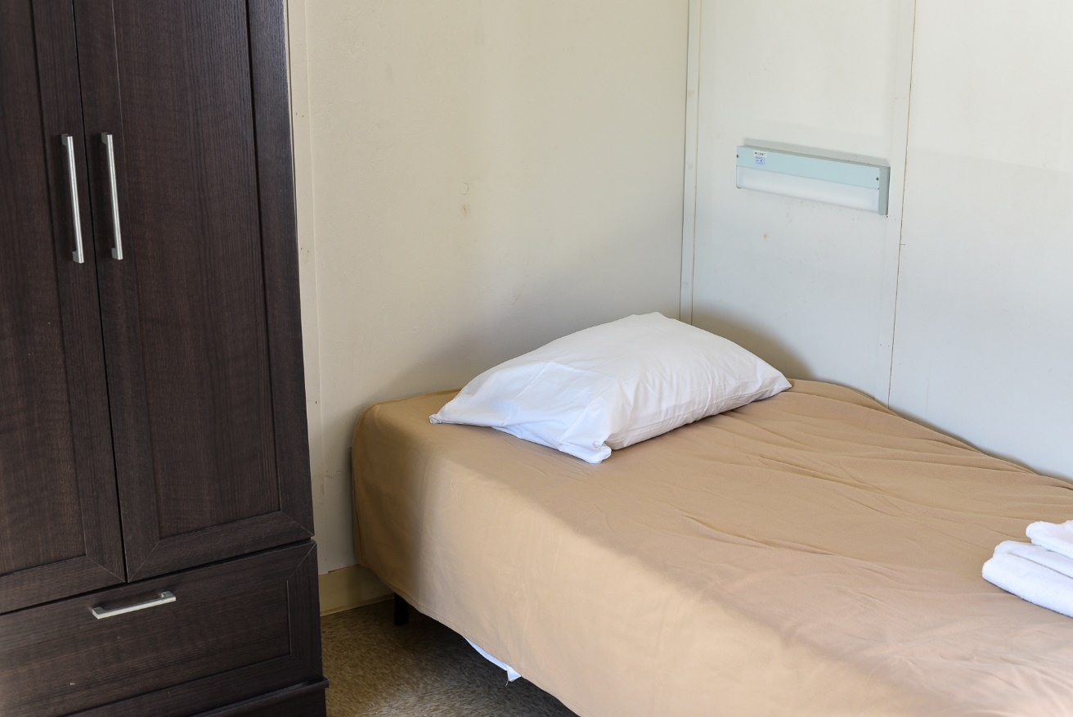
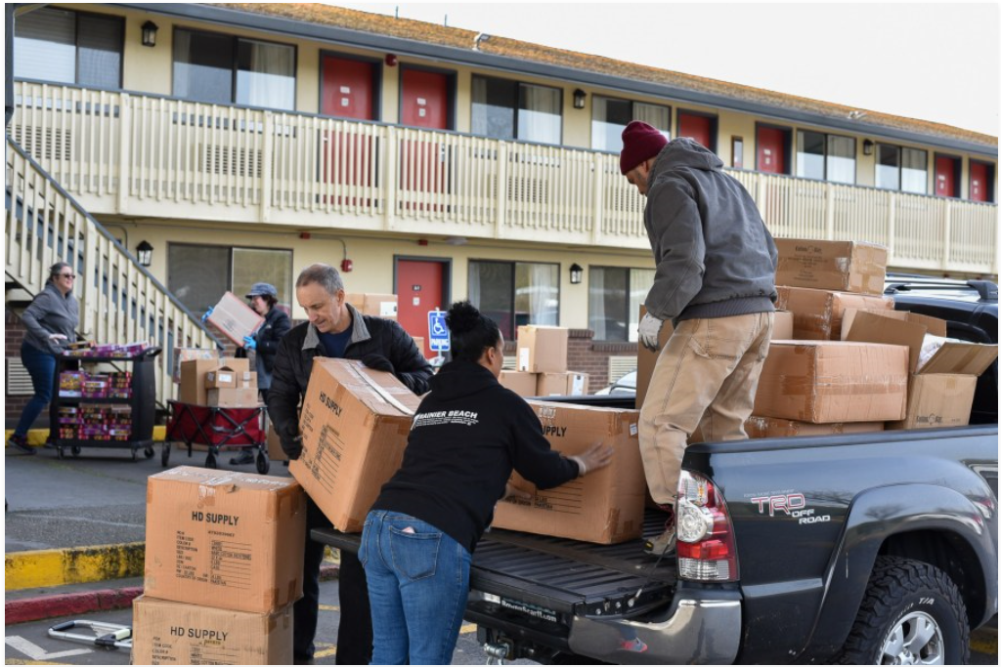
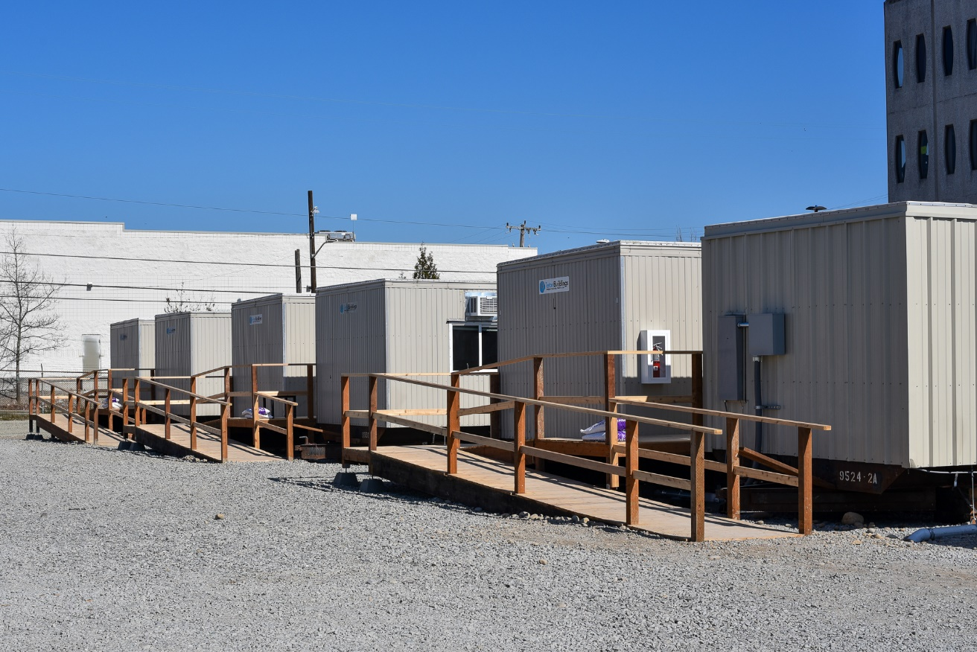
Isolation & Quarantine Locations
Notes:
JBG Presents

Slide 11
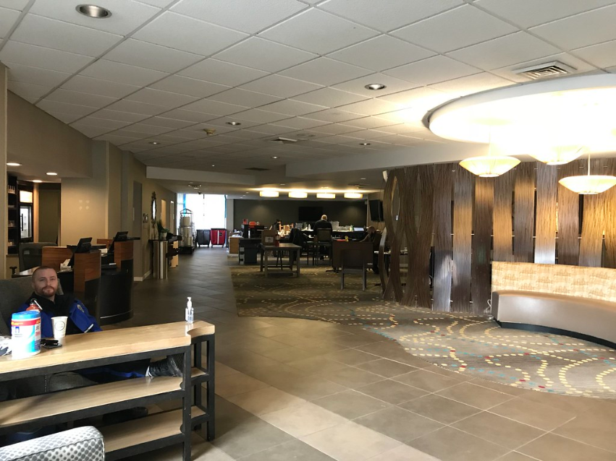

Slide 12
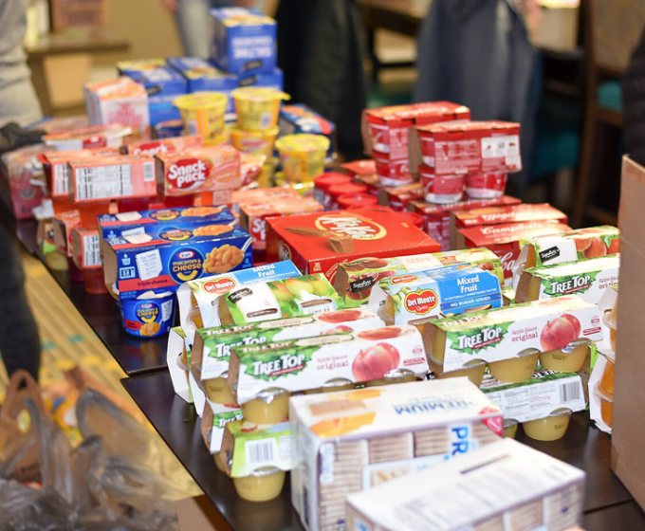
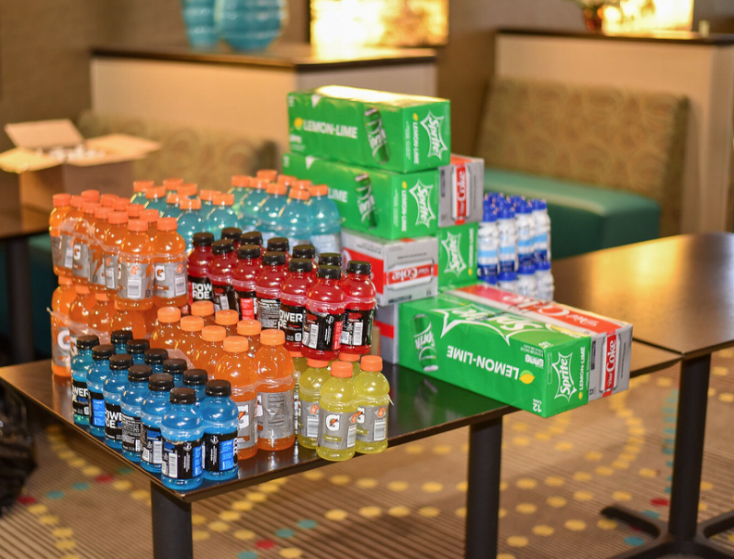
Catering by Fare Start for 3 meals per day,
plus lot of snacks!

Slide 13
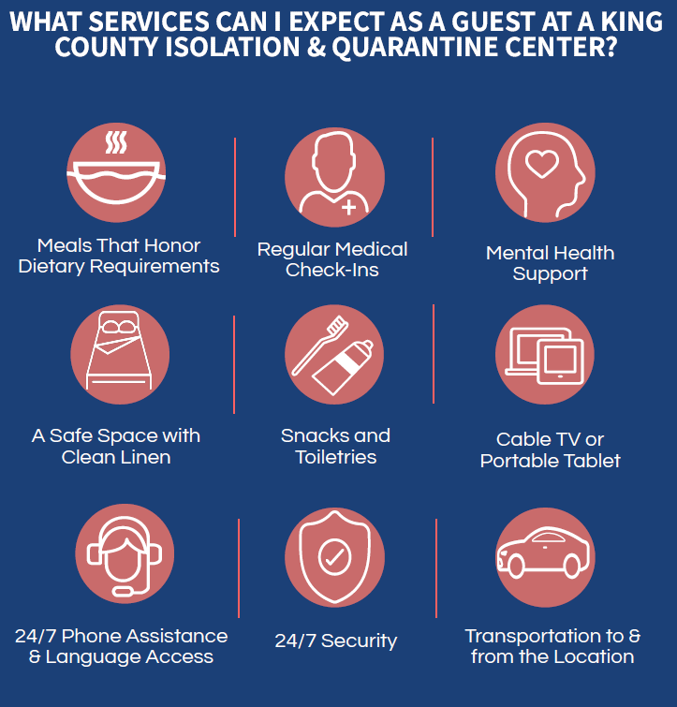
FOR PEOPLE WHO NEED A PLACE TO ISOLATE/ QUARANTINE

Slide 14
FOR PEOPLE WHO NEED A PLACE TO ISOLATE/ QUARANTINE
All are welcome, no matter race, religion, gender identity, sexual orientation, immigration status, or disability
More about I&Q centers:
Family/friends may drop off care packages, belongings, clothes, etc., however no visitors are allowed.
Language supports are available via phone-based interpretation services
Multiple household members, including children, may be roomed together in many cases.
I&Q is free for everyone and is not reported as public charge.
Documentation status is not collected.
Government-issued identification is not needed.
King County does not permit law enforcement to enter the facility without a signed judicial warrant.
CPAP/BiPAP and nebulizer machines can be accommodated (at Aurora site).
ADA accessible

Slide 15
FOR PEOPLE WHO NEED A PLACE TO ISOLATE/ QUARANTINE
Even more about I&Q centers:
Guests can bring all of their belongings.
Treatment for substance use disorder and alcohol use disorder -including Suboxone- is available onsite.
Smoking is permitted in designated smoking areas.
Service and emotional support animals are welcome, pet food is supplied. Other pets can be housed by the animal shelter until the patient is discharged.
Phones are provided to ensure that guests can stay connected with friends, family, and case managers.
All are welcome, no matter race, religion, gender identity, sexual orientation, immigration status, or disability

Slide 16
FOR PEOPLE WHO NEED A PLACE TO ISOLATE/ QUARANTINE
First Steps for Connecting to I&Q
Coronavirus Call Center is the first point of contact for providers to connect patients with King County I&Q facilities
Coronavirus Call Center: 206-477-3977
Call Center operates from 8am to 10pm, 7 days per week
Call Center will forward contact information to an I&Q Coordinator who will contact you within two hours (depending on call volume)
Public Health’s Communicable Disease-Epidemiology section may also call for any disease investigation/ contract tracing needed

Slide 17
FOR PEOPLE WHO NEED A PLACE TO ISOLATE/ QUARANTINE
Isolation and Quarantine: Assessment of Referrals
King County’s goal is to place all patients who need it in an I&Q facility to slow the spread of COVID-19
Assessment is needed to assure that patients placed in an I&Q facility will be safe and will not pose a safety risk to staff and other patients
I&Q Coordinator, working with the I&Q medial triage team and King County’s Behavioral Health and Recovery Division (BHRD), will assess if an I&Q facility is available that can provide the level of medical and/or behavioral health care and attention needed by the patient
A designation of low, medium and high behavioral need will be assigned based on available information about the patient and the clinical judgment of the screeners
Patients designated as high need may still be suitable for I&Q placement if the proper support can be provided

Slide 18
FOR PEOPLE WHO NEED A PLACE TO ISOLATE/ QUARANTINE
Admission Inclusion Criteria 5.11.20
Functional
Able to perform mobilize, transfer and perform Activities of Daily Living (eating, dressing, bathing, etc.) independently
Able to follow directions when provided appropriate language or other facilitation
Behavioral Health
Does not pose an imminent threat to self or others that warrants a higher level of care
Does not have behavioral health issues identified; or has mild or moderate behavioral health issues identified; or other complex behavioral health need, such as withdrawals/delusions, with a plan to manage
Is not in active alcohol withdrawal

Slide 19
FOR PEOPLE WHO NEED A PLACE TO ISOLATE/ QUARANTINE
Exclusions from Admission 5.11.20
Patient is unable to manage activities of daily living independently, or follow directions despite appropriate language or other facilitation
Patient poses an imminent threat to safety of self, staff or guests, (i.e. recent documented violence, arson, or predatory behavior)
Medical problems that need monitoring or treatment adjustment beyond the level that can typically be provided in outpatient care, including:
Patient requiring supplemental oxygen by nasal cannula
Exception: Patients with a preexisting (i.e. prior to illness) baseline oxygen requirement, if less than 4L per minute and in possession of all necessary equipment.
Patient requires IV medications
Patient in active alcohol withdrawal
Patients will be assessed on a case-by-case basis by behavioral health and medical screening teams.

Slide 20
FOR PEOPLE WHO NEED A PLACE TO ISOLATE/ QUARANTINE
Once a Patient is Assigned to an I&Q Facility
I&Q Coordinator will share information about the lodging site
When possible, please bring all current medications with you, we can get refills from the pharmacy if you run out while at IQ.
Transportation will be provided either by private ambulance or Metro depending on capacity and availability
An estimated time of arrival for transport will be provided. Anticipate a 1-2 hour wait time (from initial call)
Loading assistance will need to be provided by members of the patient’s household. Metro transportation staff will not have physical contact with the patient and are unable to speak with guests during transport due to the physical barrier that separates the driver.

Slide 21
FOR PEOPLE WHO NEED A PLACE TO ISOLATE/ QUARANTINE
DISCHARGE CRITERIA- HOW LONG WILL PATIENTS STAY AT I&Q
You've been sick with COVID symptoms and
you tested positive OR
you tested negative, but you spent time or shared a living space with someone who tested positive.
Leave if:
It's been 10 or more days since you first started feeling sick AND
You haven't had a fever for 24 hours AND
You are feeling better.
Nurses at the I&Q will keep track of how you are feeling and your temperature. They will let you know when you are well enough to leave.
You haven't been sick with COVID symptoms, but you tested positive.
Leave after 10 days from the date of your test.
You haven't been sick with COVID symptoms and you tested negative, but you spent time or shared a living space with someone who tested positive (quarantine).
Stay for 10 days since the last time you were with the person who tested positive.
Patients are discharged from I&Q according to these criteria to ensure that they are no longer contagious upon release.

