Slide 1
Community Living Connections

Slide 2
Citizenship

Slide 3
Updates Due to COVID-19
1. DELAYS: 1 year and 5 month wait from the time you apply until interview date
-People who applied in November 2019 have interviews for March 2021
Youth
Development
-USCIS was closed across all 50 states from March 17 to June 8th
-South King County residents were being sent to Portland and East King County residents were being sent to Yakima. This is no longer safe due to COVID-19
Employment & Adult Education
Family & Social Services
Housing Stability
Aging & Disability Srvs.
-No exceptions for pushing forward, ☹
Notes:
NH operates over 30 different programs to address the needs of those we serve.
These include the major areas of early learning, youth development, health, employment and adult education, family and social services, housing stability and aging and disability services.

Slide 4
Updates Due to COVID-19
2. Masks: All people are required to wear masks into immigration
-Mask must cover your face
-People will not be able to enter the building without a mask and their appointments will be rescheduled
Youth
Development
Employment & Adult Education
Family & Social Services
Aging & Disability Srvs.
Notes:
NH operates over 30 different programs to address the needs of those we serve.
These include the major areas of early learning, youth development, health, employment and adult education, family and social services, housing stability and aging and disability services.

Slide 5
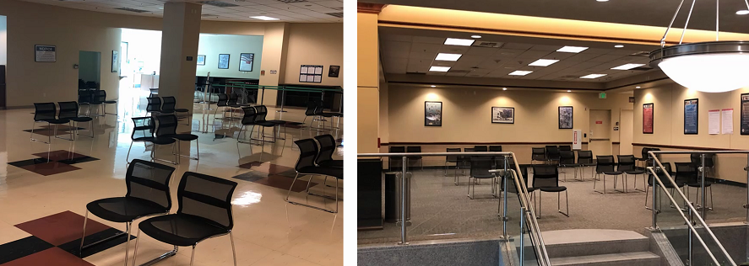
Updates Due to COVD-19
3. Tukwila Office Protocol
-Can only arrive 15 minutes before
-Hand sanitizer at the exit and entrance
-One entry and one exit
Notes:
We have locations across King County, centrally located in areas where low income individuals and households live, work, and go to school.

Slide 6
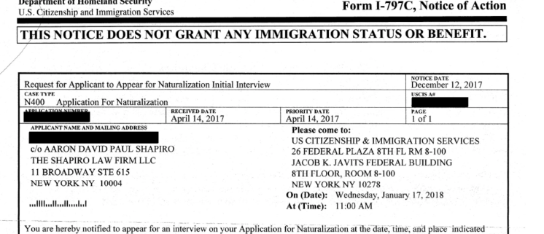
Updates Due to COVID-19
4. Extended hours: to social distance and get through more applications
-Interviews start as early as 6:30am and go until 3:30pm
Youth
Development
Employment & Adult Education
Family & Social Services
Aging & Disability Srvs.
Notes:
NH operates over 30 different programs to address the needs of those we serve.
These include the major areas of early learning, youth development, health, employment and adult education, family and social services, housing stability and aging and disability services.

Slide 7
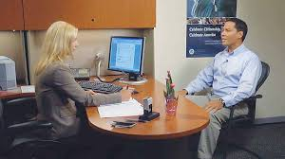
Updates Due to COVID-19
5. Lawyers/Legal Representatives and Translators
-Lawyers and Legal Representatives can attend
-Using the language line is preferred for translation
*Care givers can attend and be the translators
*Officer may or may not let more than 2 people in the room
-IF they say no, they will call one
Youth
Development
Employment & Adult Education
Aging & Disability Srvs.
Notes:
NH operates over 30 different programs to address the needs of those we serve.
These include the major areas of early learning, youth development, health, employment and adult education, family and social services, housing stability and aging and disability services.

Slide 8
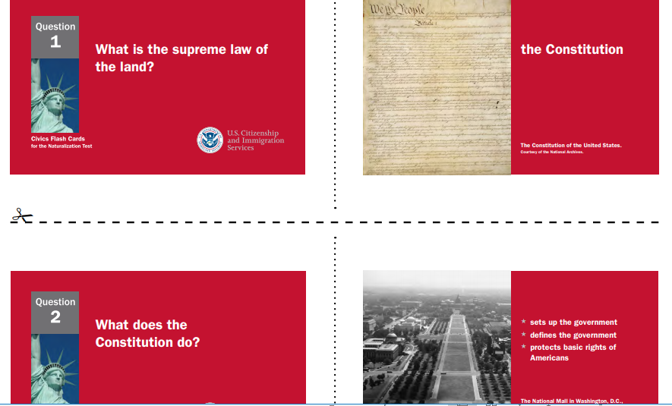
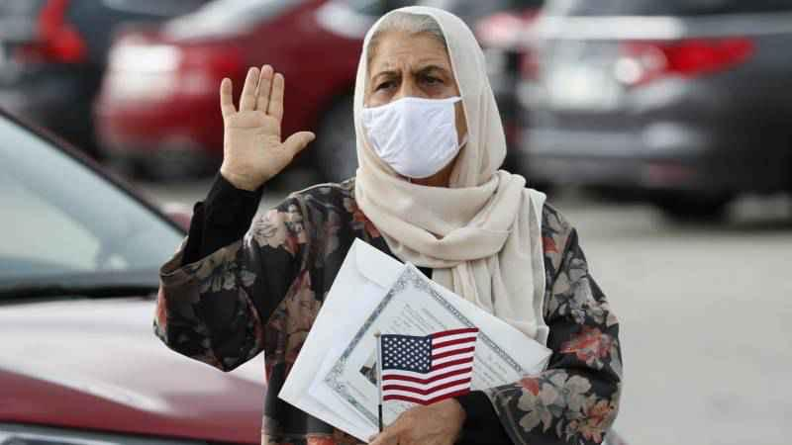
Updates Due to COVID-19
5. Civics Test: NO CHANGE
-Previous administration tried to change the test to 128 questions
*12 out of 20 to pass
-Current administration went back to 100 questions
Youth
Development
*6 out of 10
Family & Social Services
Aging & Disability Srvs.
Employment & Adult Education
Notes:
NH operates over 30 different programs to address the needs of those we serve.
These include the major areas of early learning, youth development, health, employment and adult education, family and social services, housing stability and aging and disability services.

Slide 9
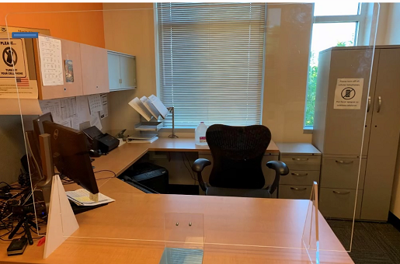
Updates Due to COVID-19
7. Oath of Allegiance: If you pass you take the Oath the same day with the officer
-Stand up and repeat the Oath with the officer
-Go into the waiting room and they call your name and hand you your certificate
Youth
Development
*From start to finish
about one hour
*With a translator
1 hour and 30 to 2
hours
Employment & Adult Education
Family & Social Services
Aging & Disability Srvs.
Notes:
NH operates over 30 different programs to address the needs of those we serve.
These include the major areas of early learning, youth development, health, employment and adult education, family and social services, housing stability and aging and disability services.

Slide 10
FOR MORE INFORMATION: Marissa Graff DOJ Representative and Citizenship Instructor marissag@nhwa.org (206)734-0366
Notes:
Update slide with presenter’s contact info

